Slide 1
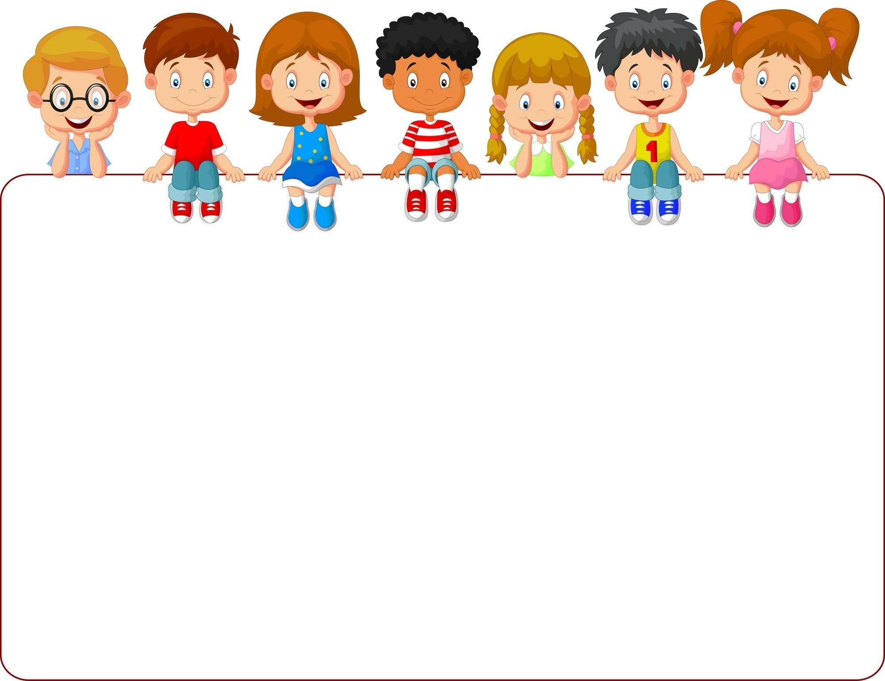
Unit 1:
Living and Non-living Things

Slide 2
Let’s go to lesson 2!
“Needs of Living Things”
Watch the next video about living things:
https://www.youtube.com/watch?v=bWBrusrCmX4&feature=youtu.be

Slide 3
Needs of living things
Air
Sunlight
Water
Food

Slide 4
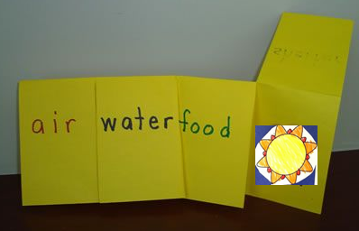
Hands on!
1. You need a paper, a pencil and scissors.
2. Follow the model to make the activity
“FLIP- FLAP BOOK”
Read the instructions on the next diapo.

Slide 5
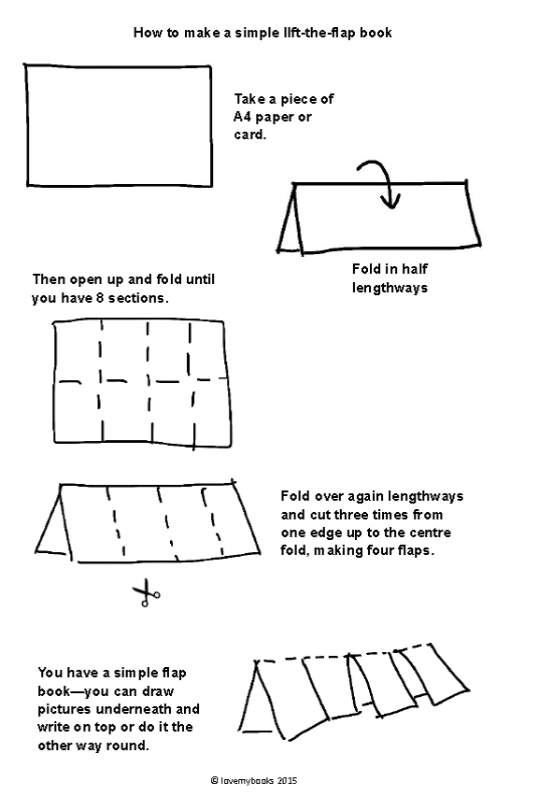
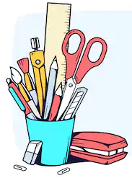
How to make a
FLIP-FLAP BOOK!
Materials:
Paper
Scissors
Pencils
Write over each flap one of the living thing needs and draw underneath a symbol that help you to remind it.

Slide 6
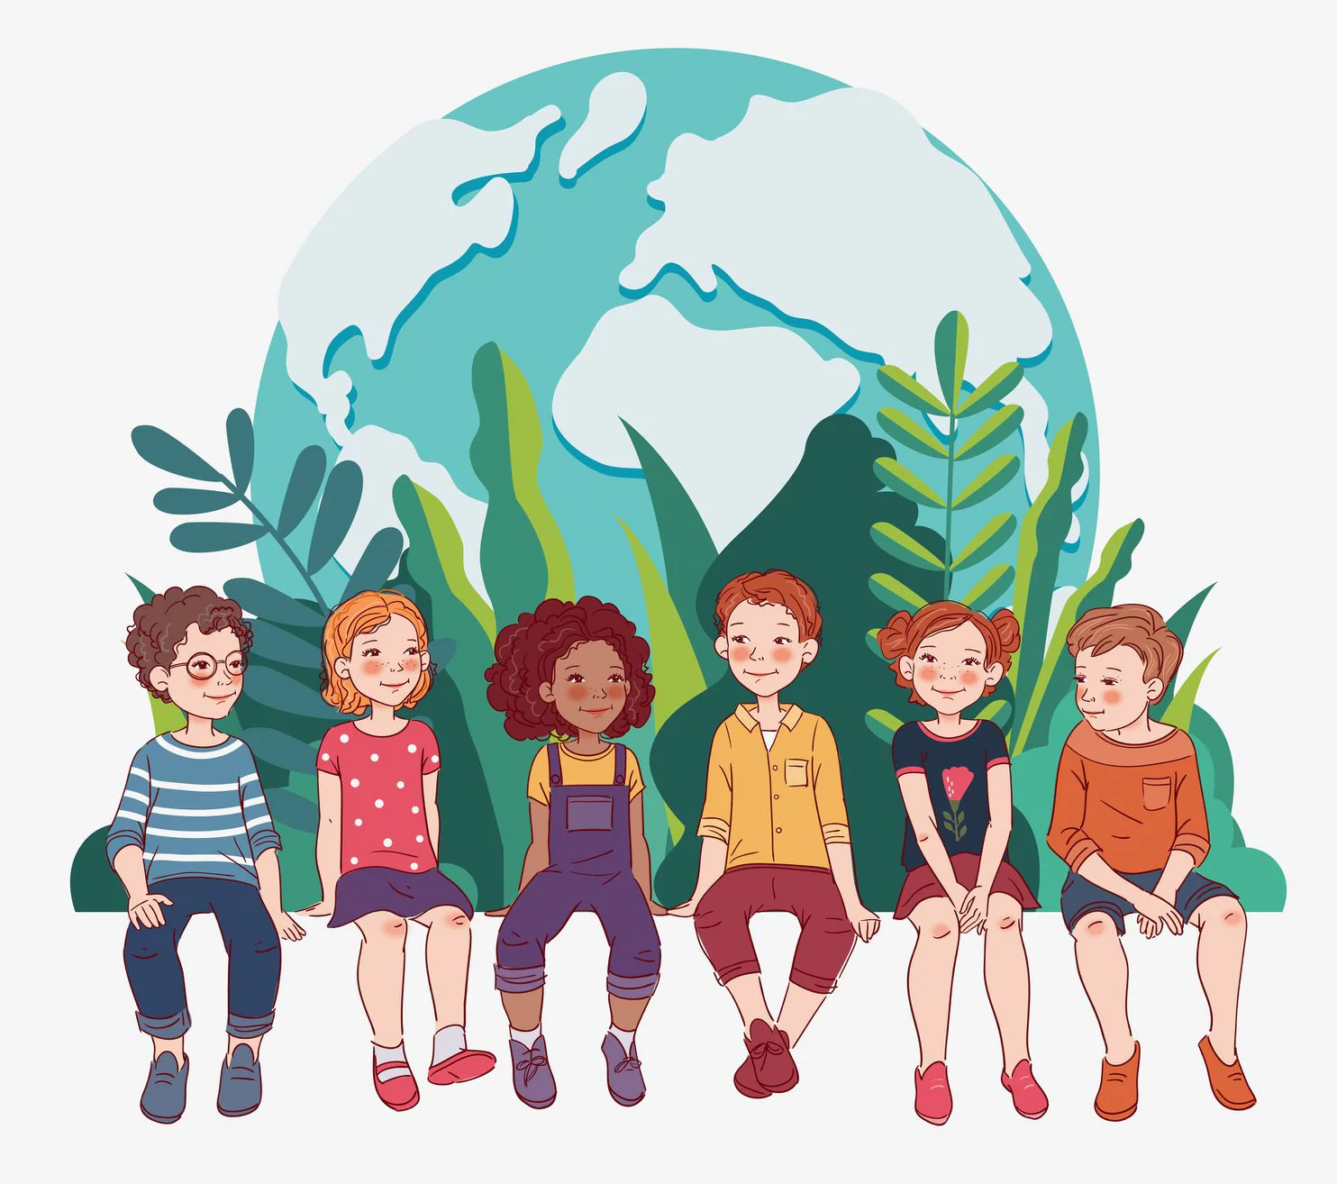
THE WORLD AND US
We are human beings, we are part of the living things so, we have needs.
Thinking in what are you feeling during the quarantine:
Are social relations a need for you?
What are you doing to supply that need?

