Slide 1
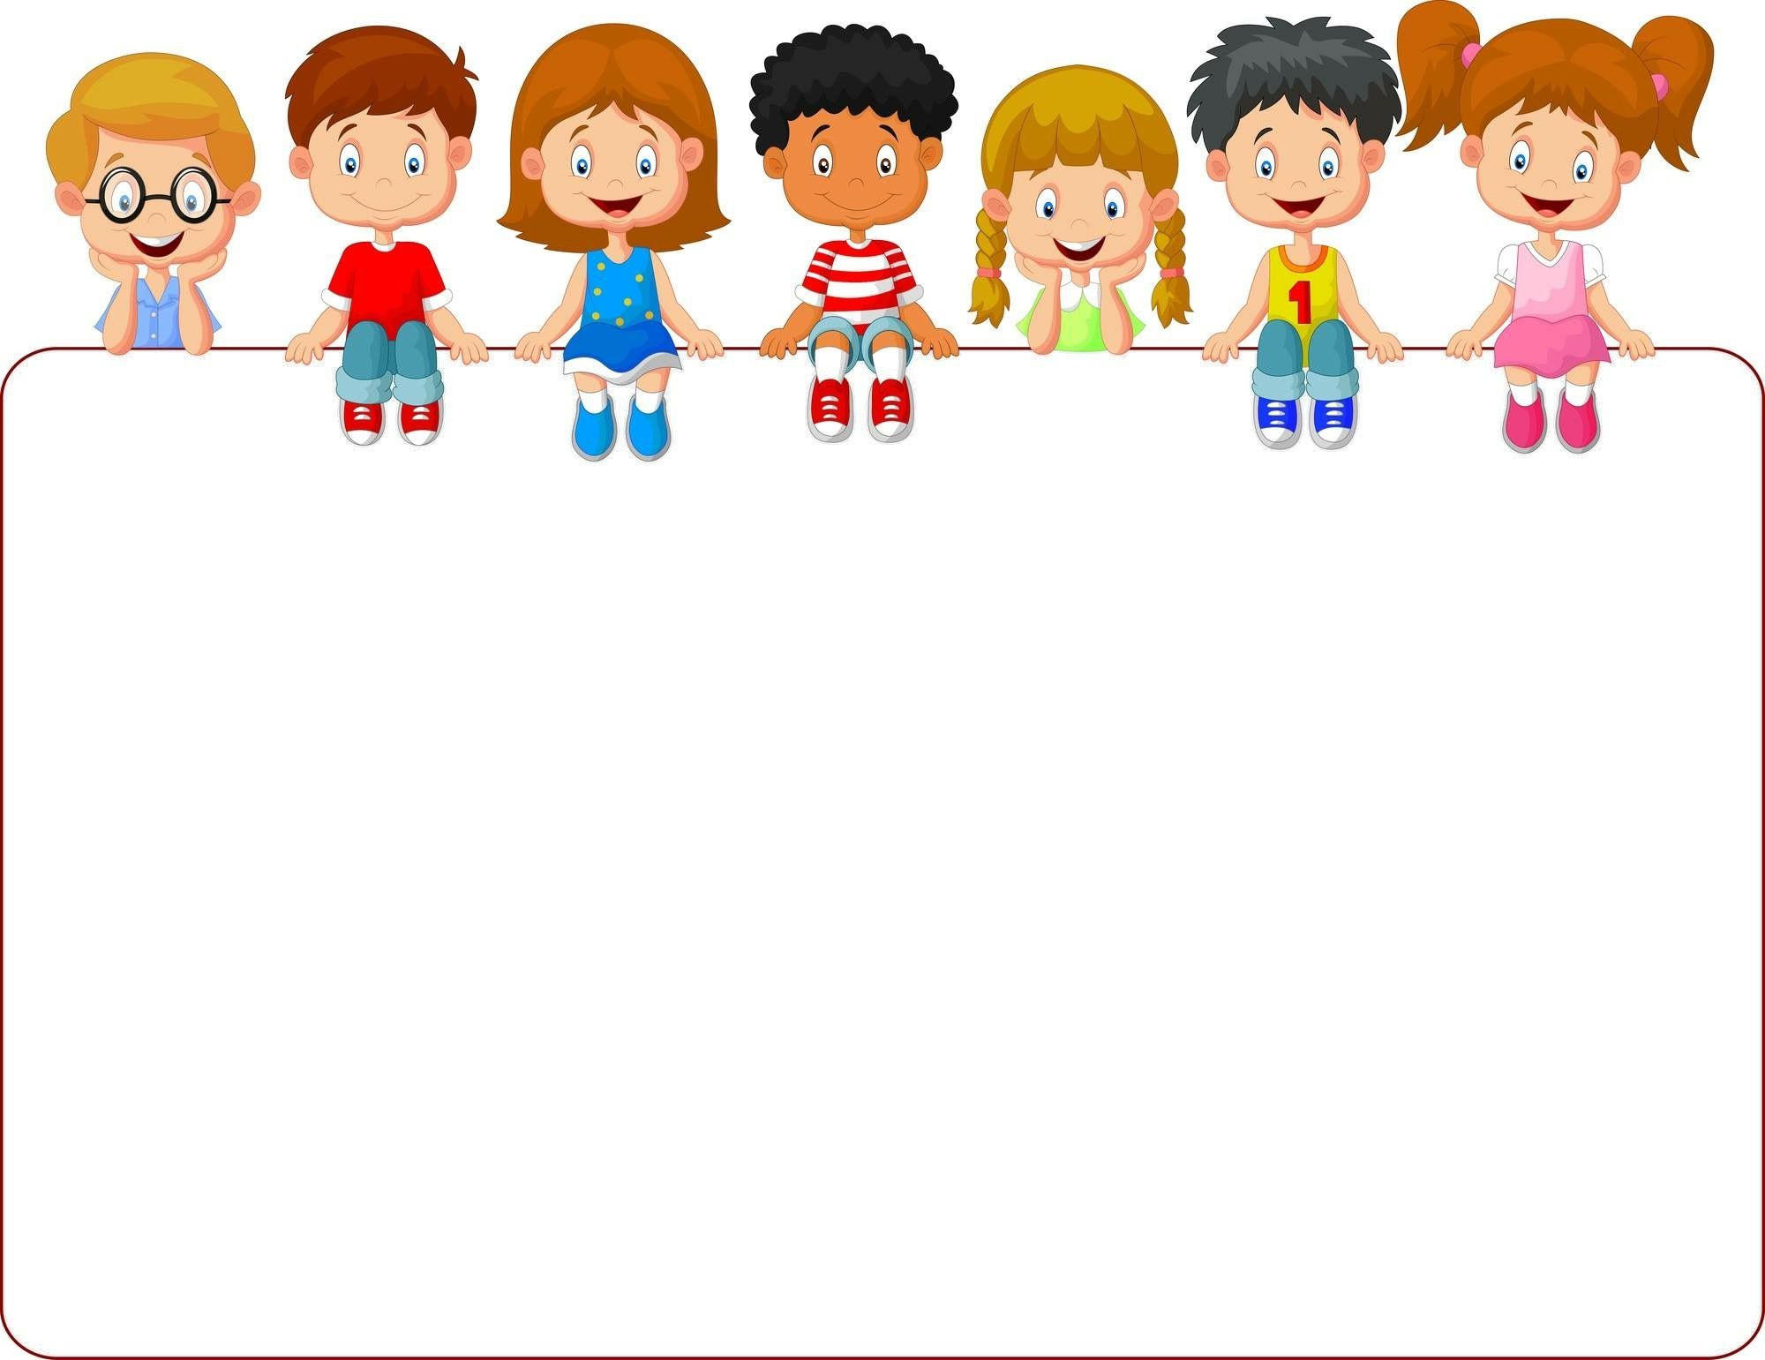
Unit 1:
Living and Non-living Things

Slide 2
Lesson 1:
Do you know what “living things” are?
Could you give examples of “living things”?

Slide 3
Activity: Can you see a living thing?
Materials: Paper and markers
Fold a paper in the middle, and then do it again
to form four squares.
2. Walk around your house, could be inside or in your backyard, your balcony or a window, trying to find living things.
3. Choose 4 living things that you saw and draw each one in each square.
4. Keep your work for sharing with the class.

Slide 4
Videos for you to watch and learn!
https://www.youtube.com/watch?v=BEz7RPvQCAI
https://www.youtube.com/watch?v=tzN299RpJHA

