Slide 1
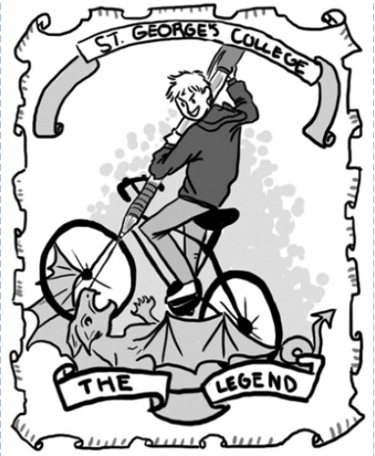
The Legend
An English-Language magazine for news from all of the grades! Independently written by students and teachers at St. George’s College for your reading pleasure.
Issue 1 2021 Bimester 1
In This Issue
02: PreKinder English
03: Kinder English
04: 1st Grade English
05 1st & 2nd Grade Science
06 - 07: 1st & 2nd Grade
08 - 09: 3rd Grade
10 - 13: 4th Grade
14 - 16: 5th Grade
17 - 18: 6th Grade
19: 7th Grade
20 - 22: 8th Grade
23 - 24: 9th Grade
25: 11th Grade
26 - 27: 12th Grade-Global English
28: 12th Grade - Forensic Science
29: 12th Grade - Science Fiction
Faculty Creator: Adriana Marrero Faculty Editor: Amy Brabec

Slide 2
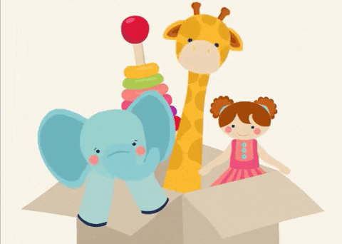
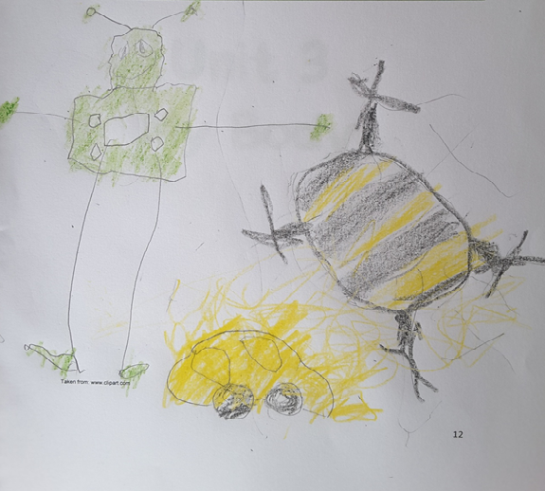
I Unit - Pre-K English 2
During the last weeks, Pre Kinder students have been learning about “Toys and Playground Games”.
In this picture José Pedro I. from PKG shows us his beautiful drawing related to his favorite toys at home.

Slide 3
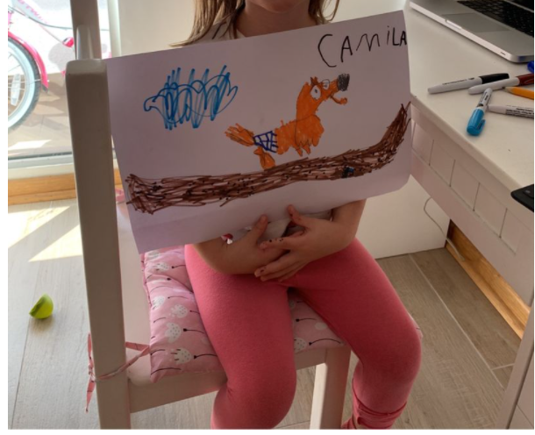
I Unit - Kinder English 3
During a Kinder online Storytime children listened to the story: “I’m the best” written by Lucy Cousins.
Camila G. from Kinder C shared this wonderful work related to her favorite part of the story. She drew the main character.
Camila Gutiérrez, KK C

Slide 4
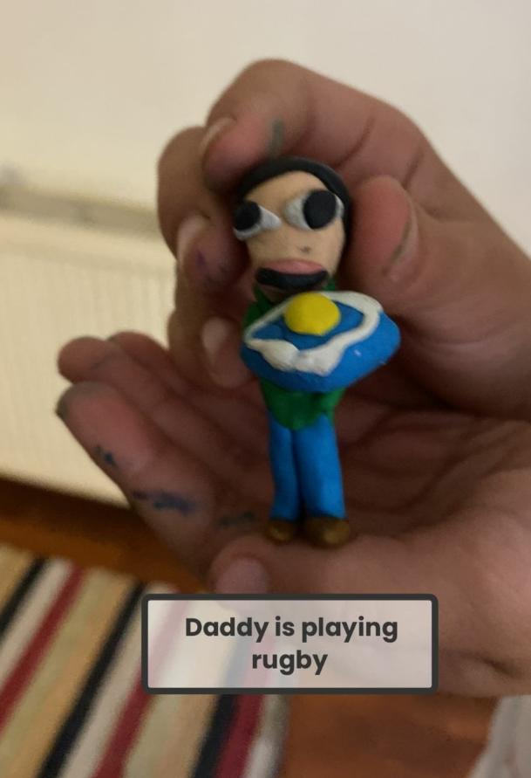
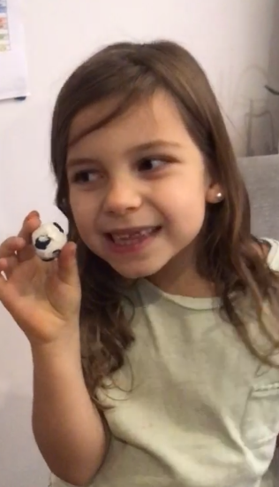
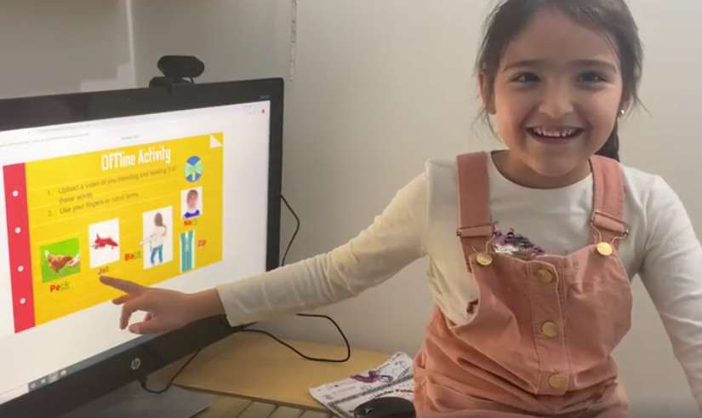
I Unit - 1st Grade English 4
During this unit, students and teachers had the chance to get to know one another and talk about their names, family members, hobbies and sounds.
Antonia (1A)
Lucas (1E)
Valentina (1D)
Helena (1C)
Olivia (1B)

Slide 5
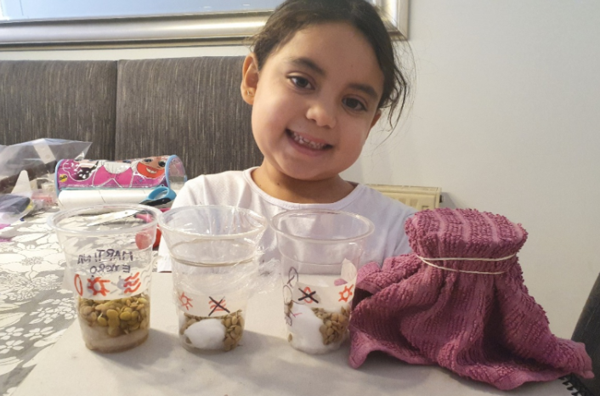
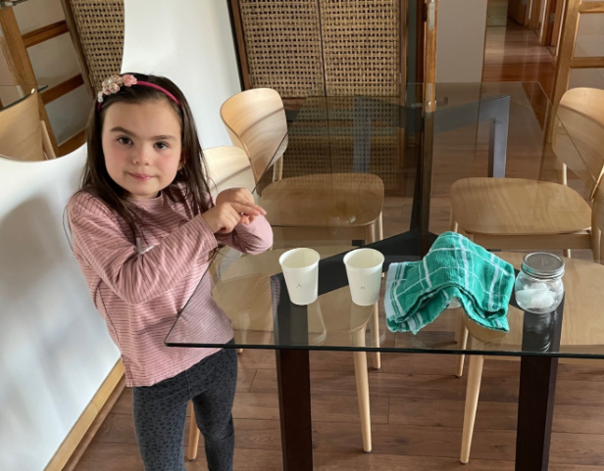
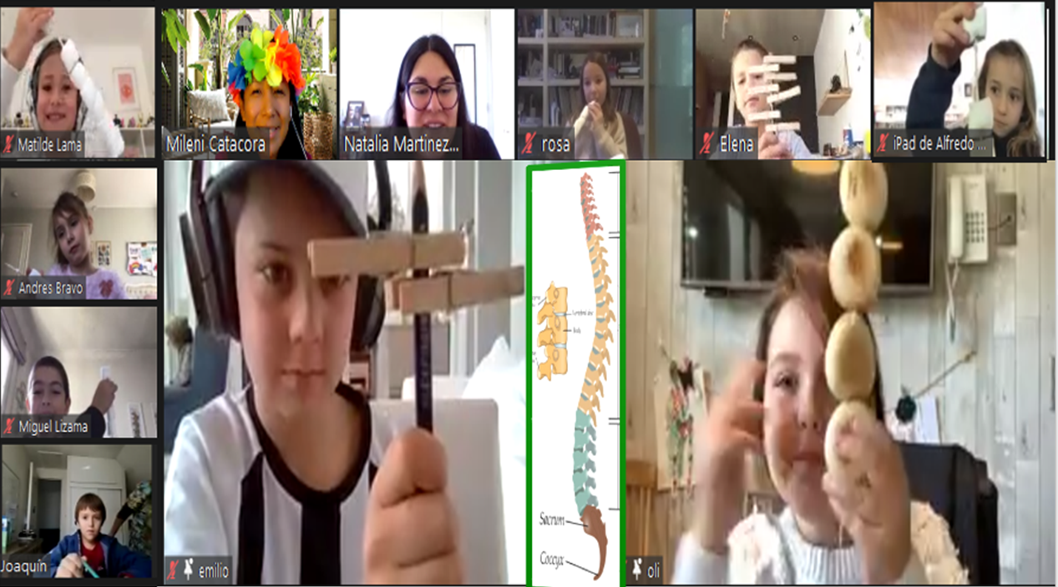
I Unit - 1st & 2nd Grade Science 5
Science is fun in English!
This bimester, 1st and 2nd grade have enjoyed the wonderful world of natural sciences by experimenting like real scientists.
1st graders planted lentils to see how they grow in different environments!
2nd graders have been experimenting with different materials to see how our backbone works.
Martina and Josefina (1D)
2°D : Matilde, Blanca, Miguel, Joaquín, Rosa, José, Ema, Emilio, and Olivia

Slide 6
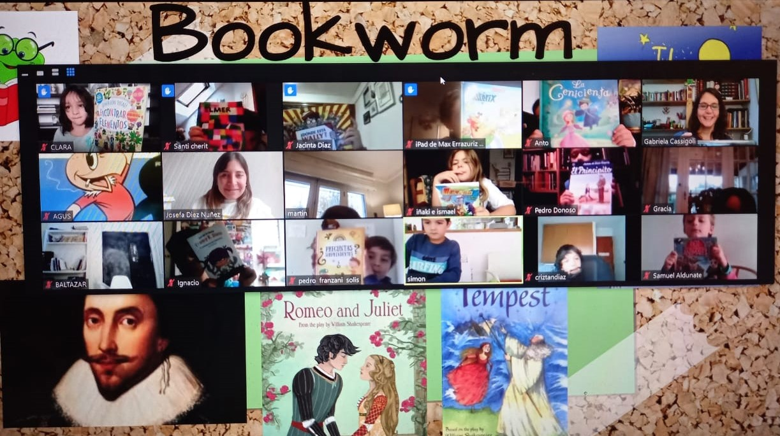
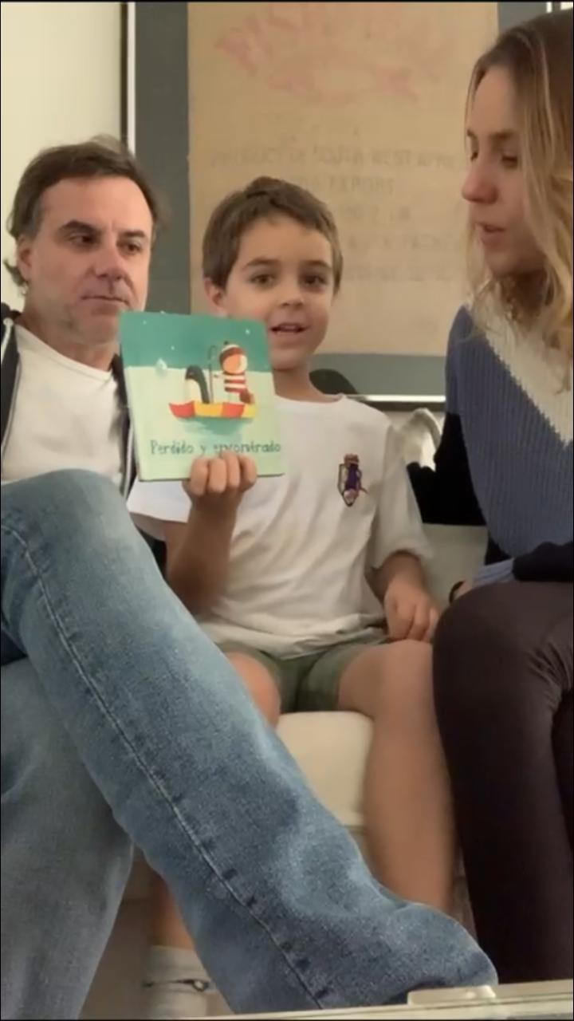
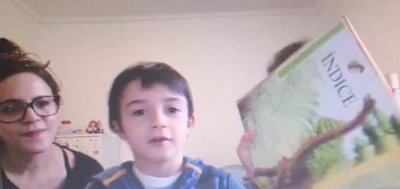
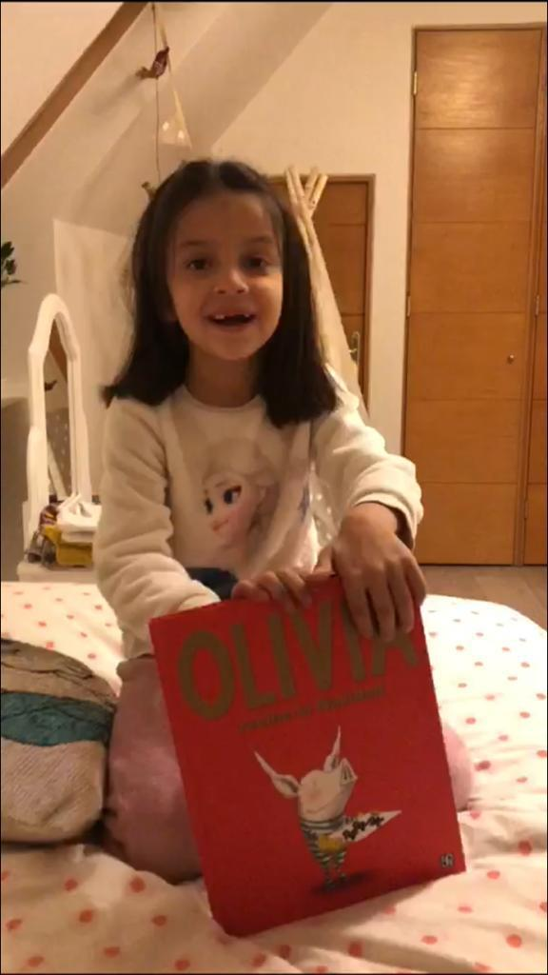
I Unit - 1st & 2nd Grade! 6
We celebrated the international Bookworm Day where students from first and second grades and their families talked about their favorite books, authors, and illustrators in front of the class. This reminded us how important and beautiful is to read and recommend books to others.
Bookworm Day Celebration 1B
Left: Pedro (1C)
Above: Gaspar (1D)
Right: María (1C)

Slide 7
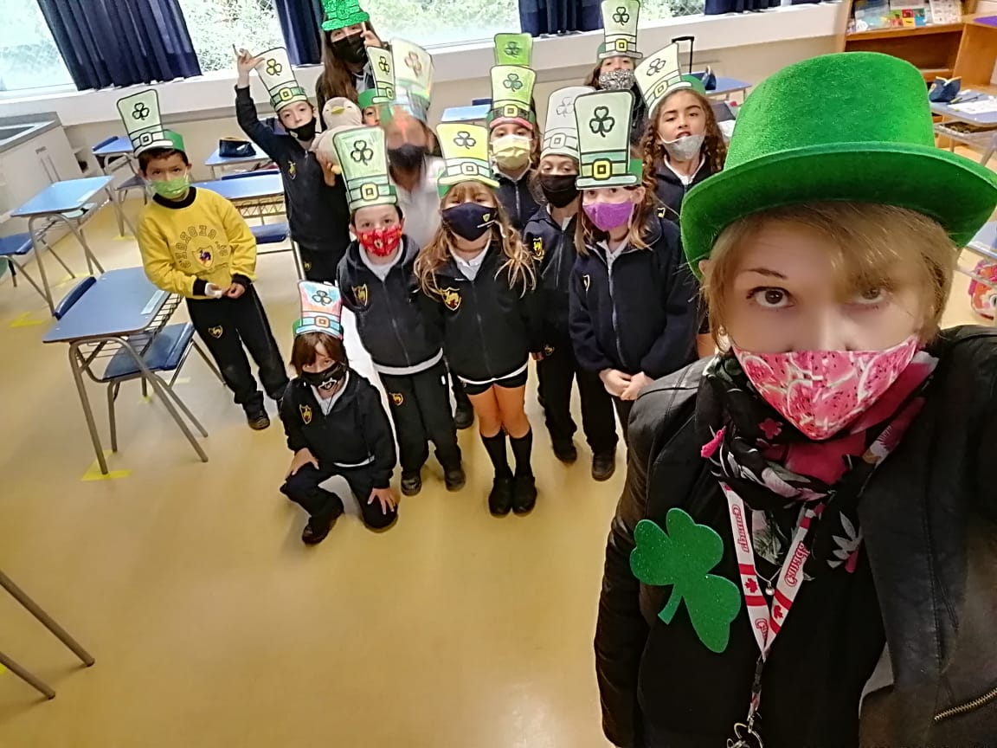
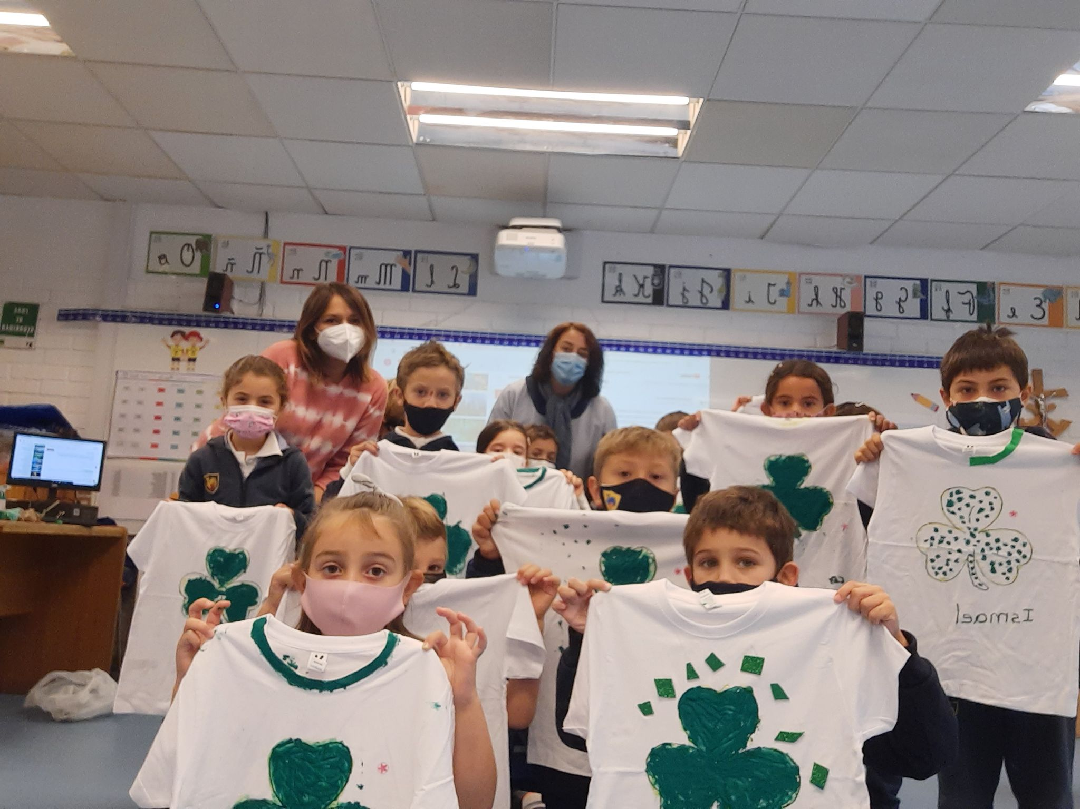
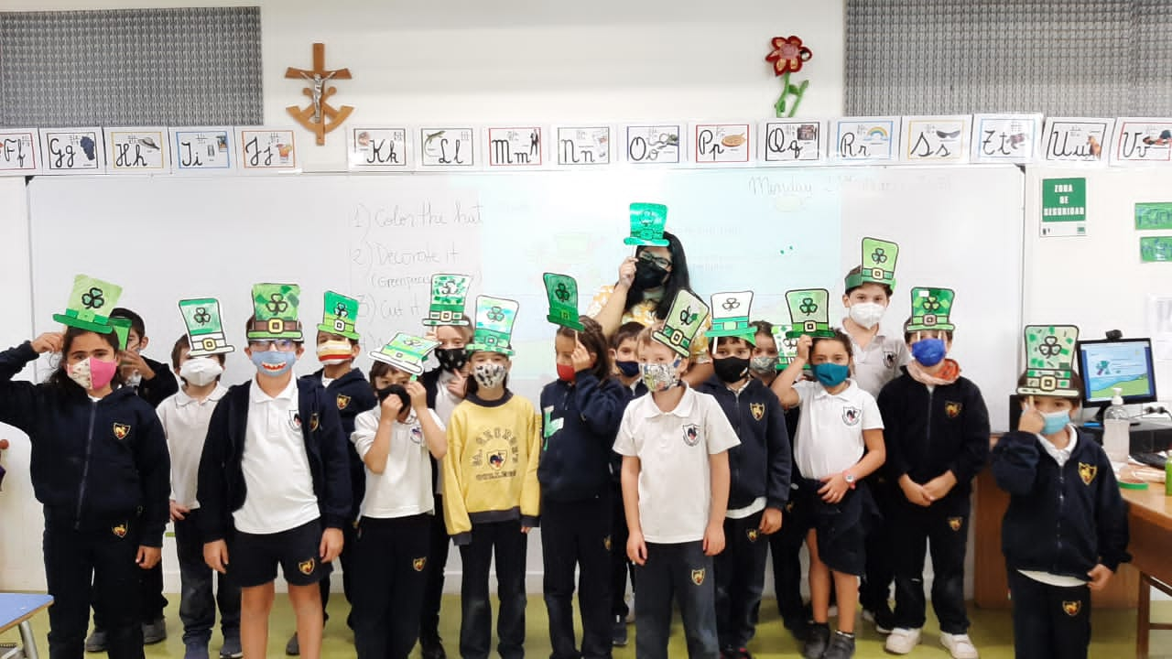
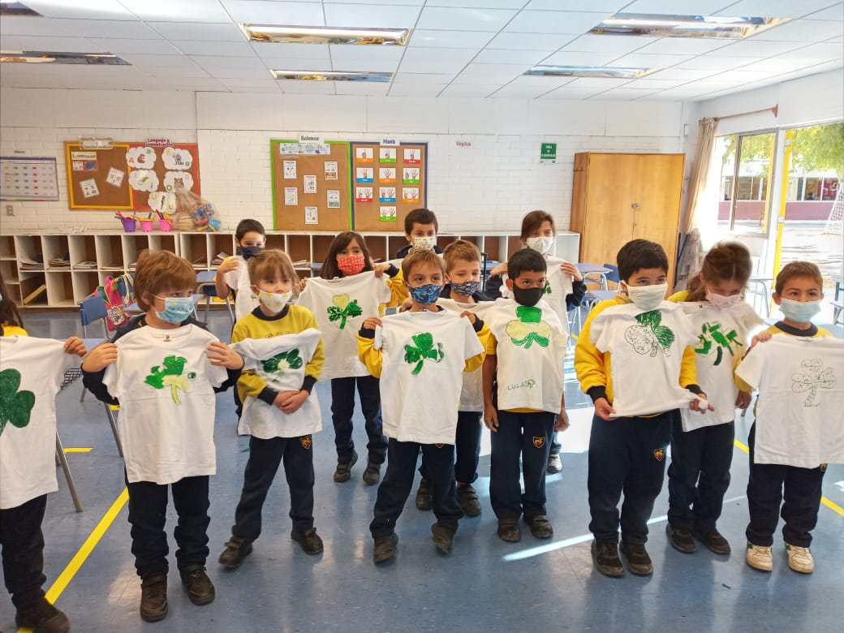
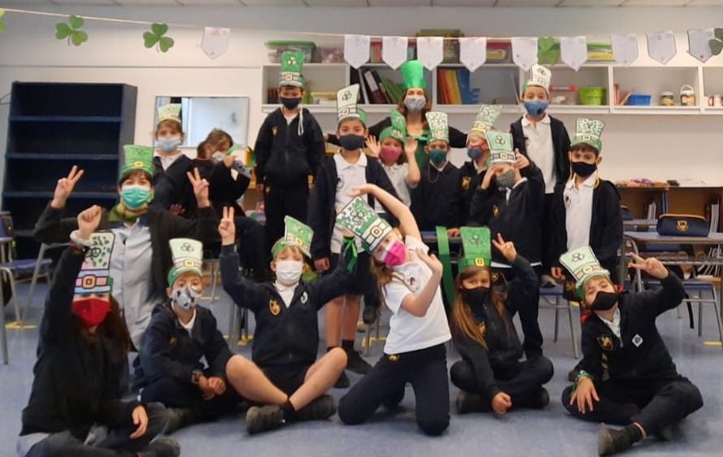
I Unit - 1st & 2nd Grade! (continued) 7
1st & 2nd graders celebrated Saint Patrick's day! We created beautiful shirts and hats, and learned the history of this holiday and Saint Patrick’s life and mission.
From top left: 2°D, 2°E, 1°A, 1°C, 2°B

Slide 8
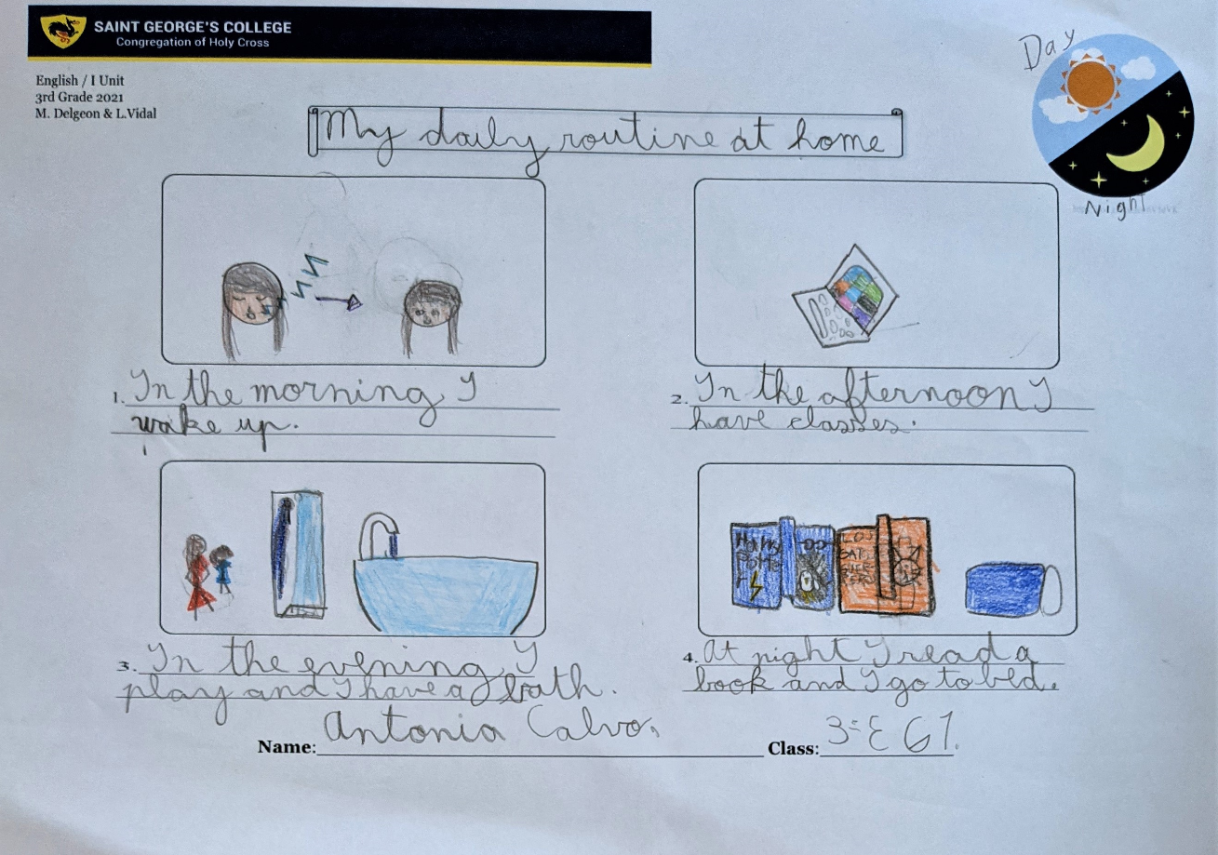
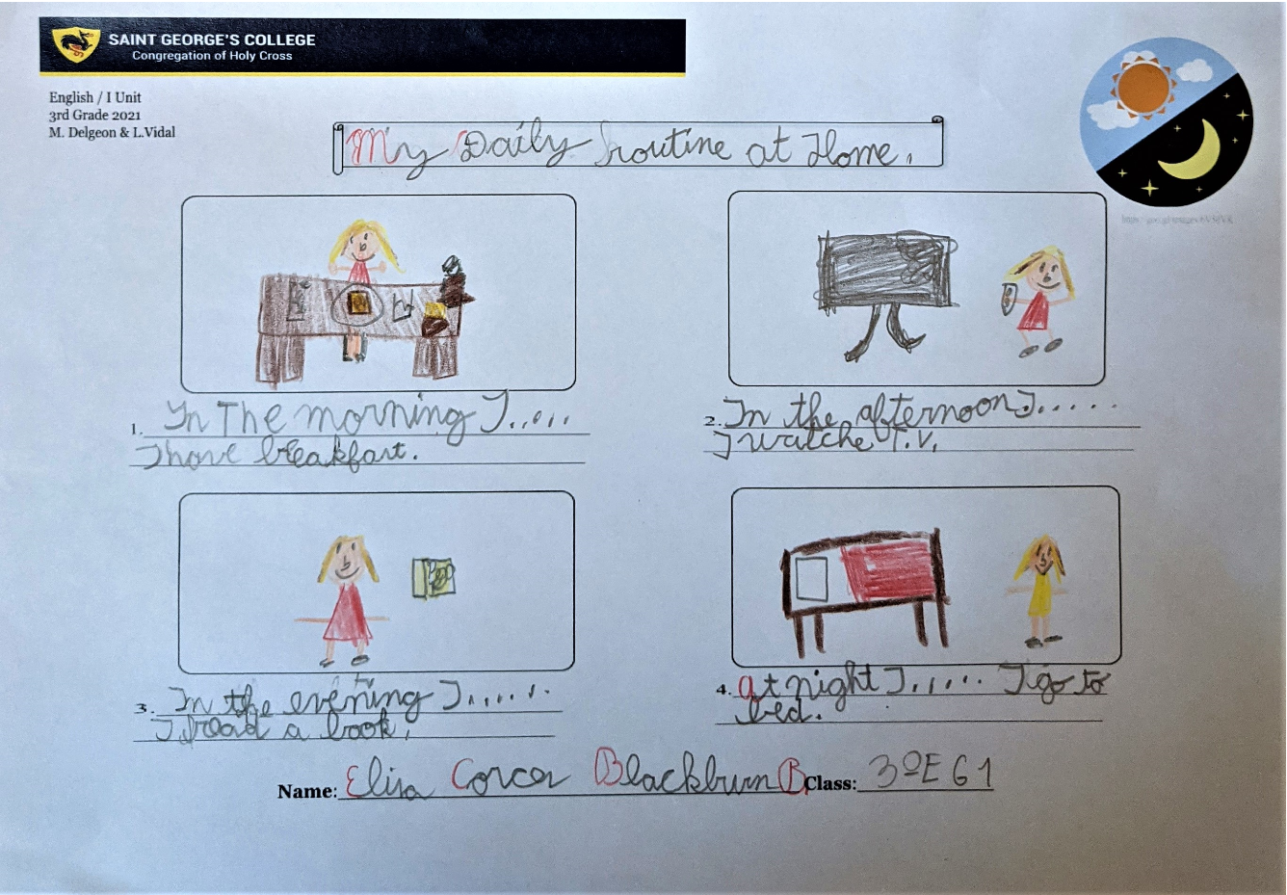
I Unit - 3rd Grade 8
During 1st Bimester, 3rd Graders worked on a project called “My Daily Routine at Home''. Students wrote sentences describing the activities they do at home as part of their daily routine. Then, they orally shared their routine with classmates.
Antonia 3E
Elisa 3E

Slide 9
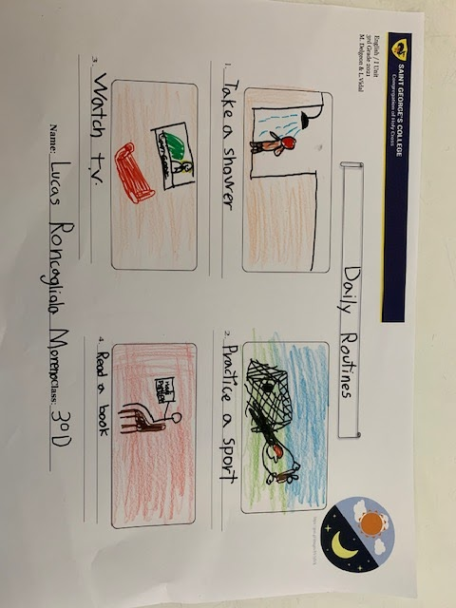
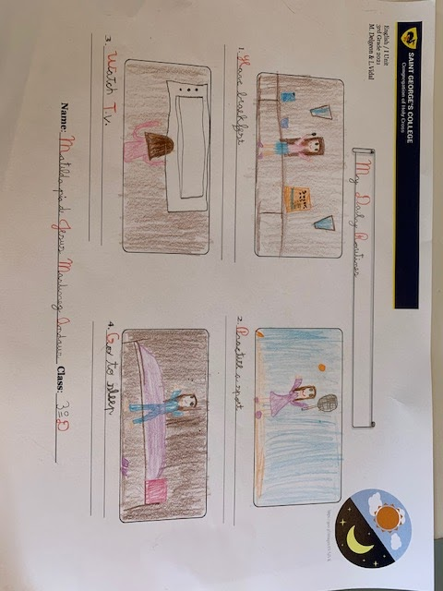
I Unit - 3rd Grade (continued) 9
Lucas 3D
Matilda 3D

Slide 10
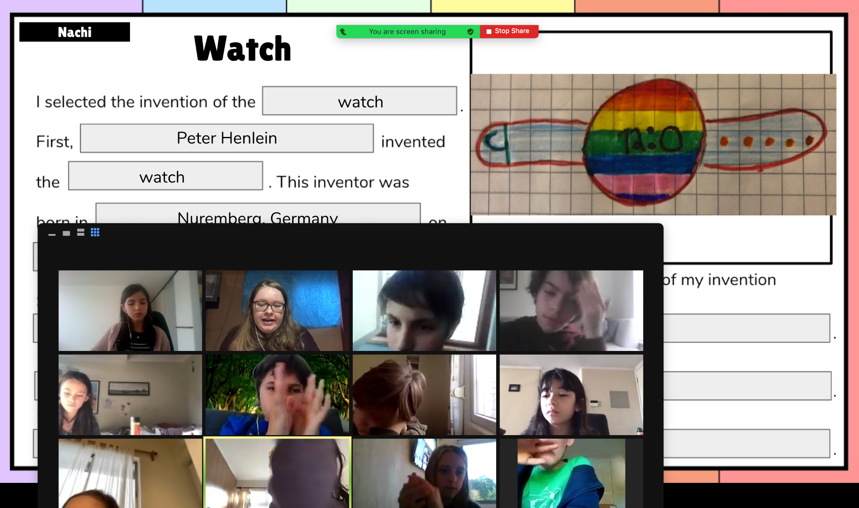
I Unit - 4th Grade 10
Our 4th graders discovered how inventors develop creative solutions to everyday problems. After learning vocabulary about inventions and practicing ordinal numbers and past tense verbs, students began the inventions project.
José (4D, Group 1) presents the invention of the iPad
María Ignacia (4A Group 1) presents the invention of the watch
Students shared their learning with classmates by presenting their written report and drawing.

Slide 11
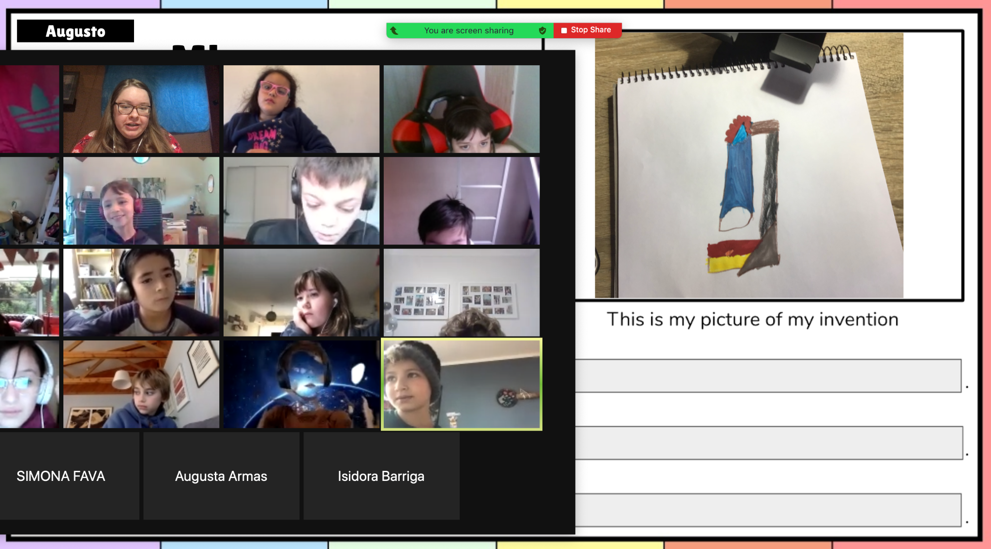
I Unit - 4th Grade (continued) 11
Diego H (4D Group 1) presents the invention of legos
Augusto (4C, Group 1)
presents the invention of the microscope
“The Computer”
Victoria
(4B, Group 2)

Slide 12
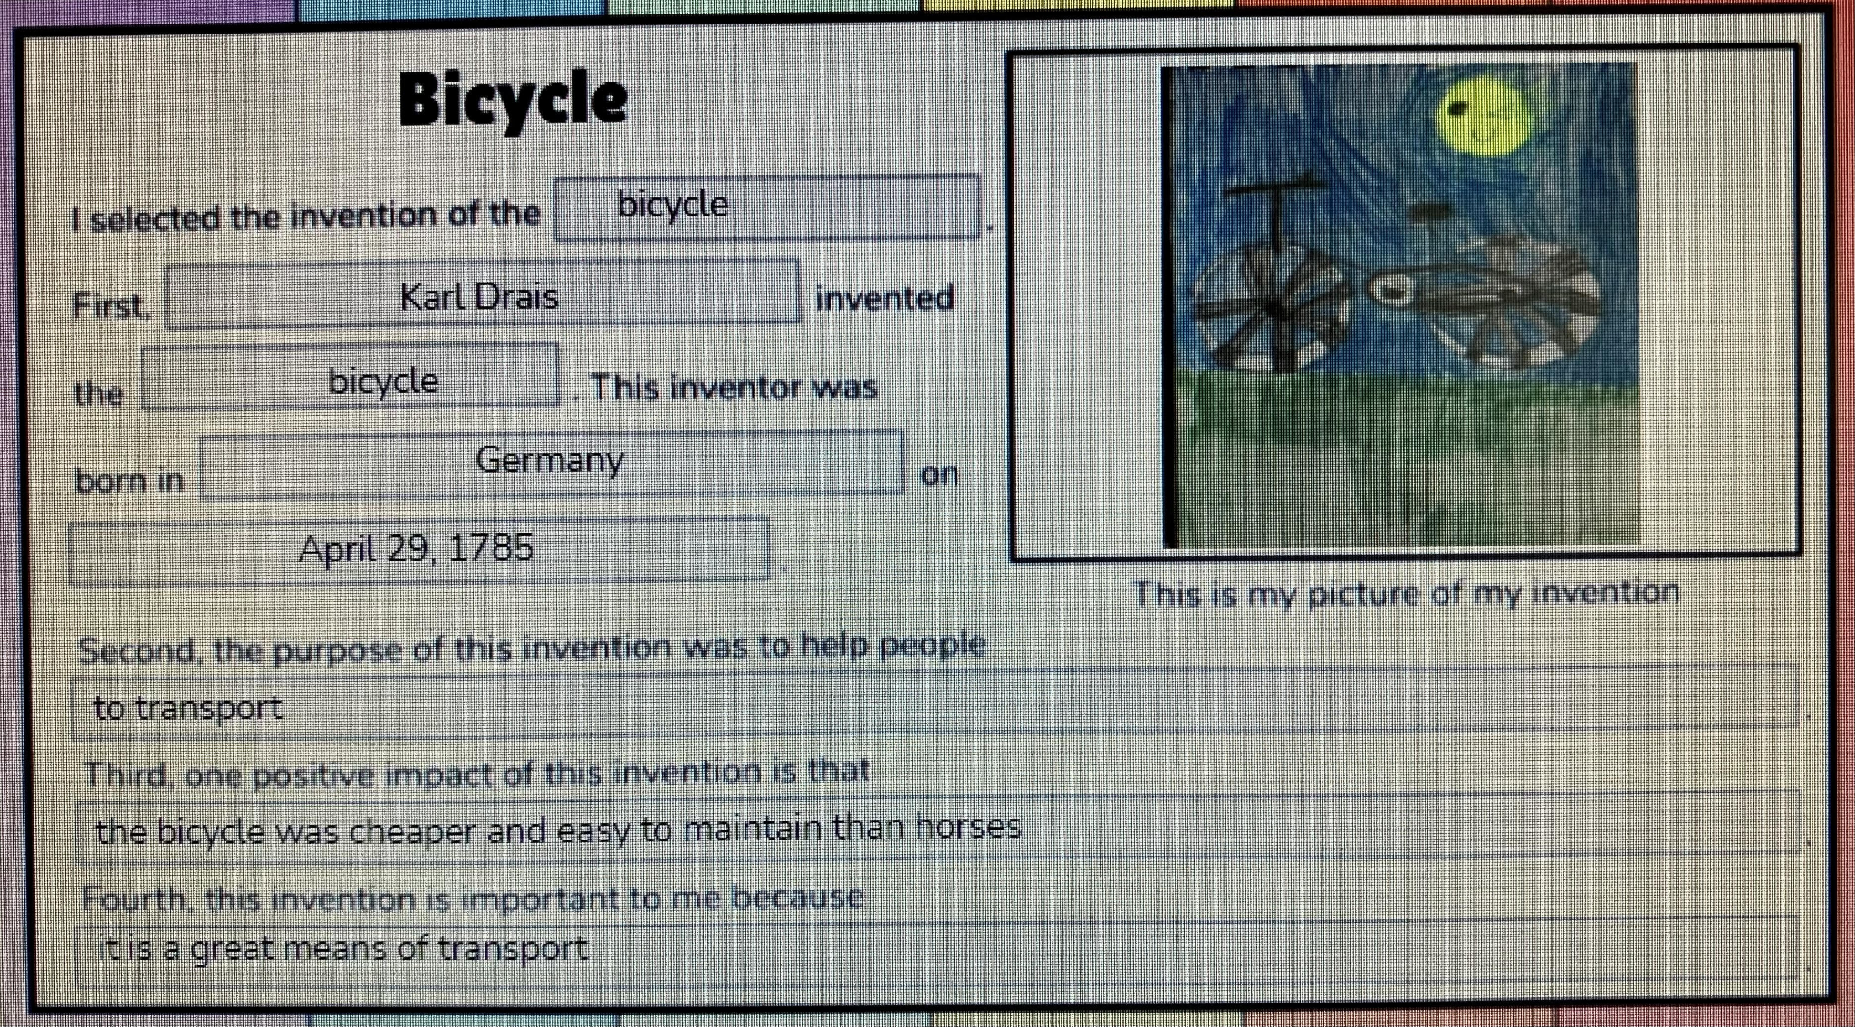
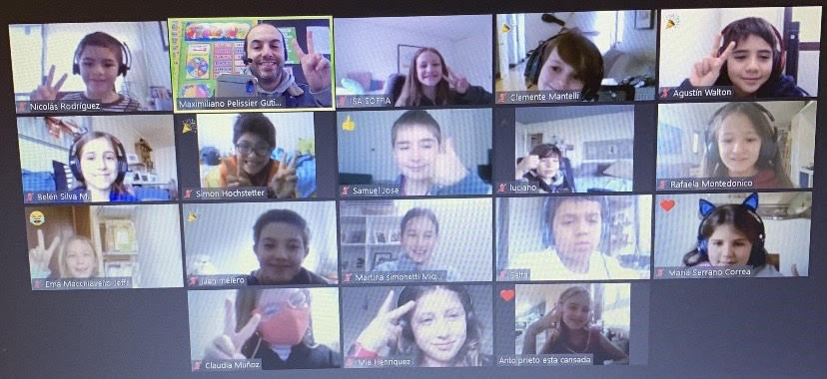
I Unit - 4th Grade (continued) 12
“The Bicycle” by Emilia
(4D, Group 2)
“The Car”, Joaquín
(4C, Group 2)
4A Group 2 after finishing their oral presentations!

Slide 13
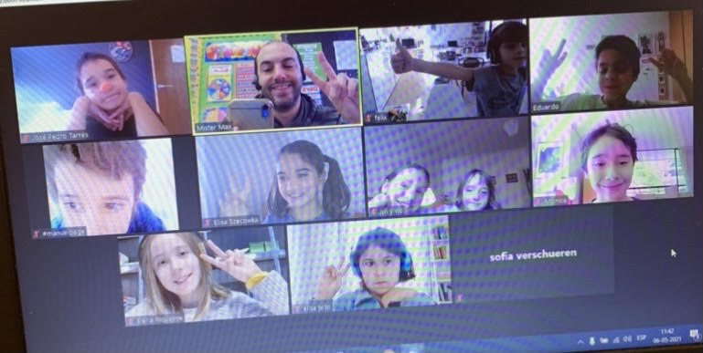
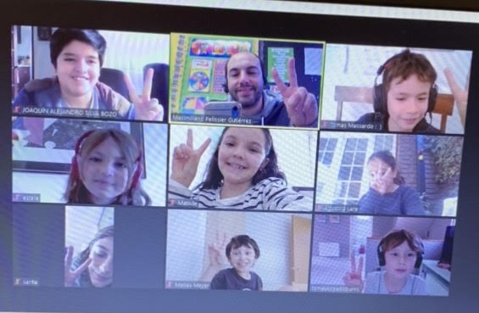
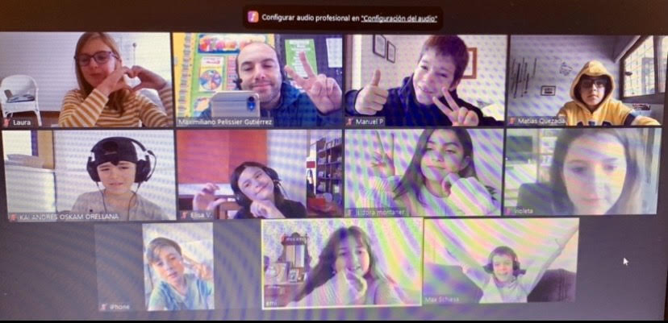
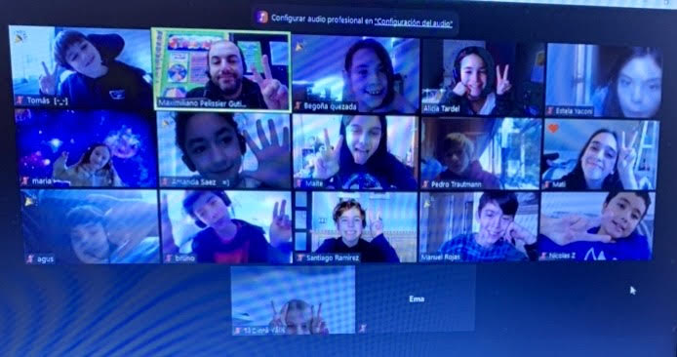
I Unit - 4th Grade (continued) 13
We completed our presentations!
4B Group 2
4C Group 2
4D Group 2
4E Group 2

Slide 14
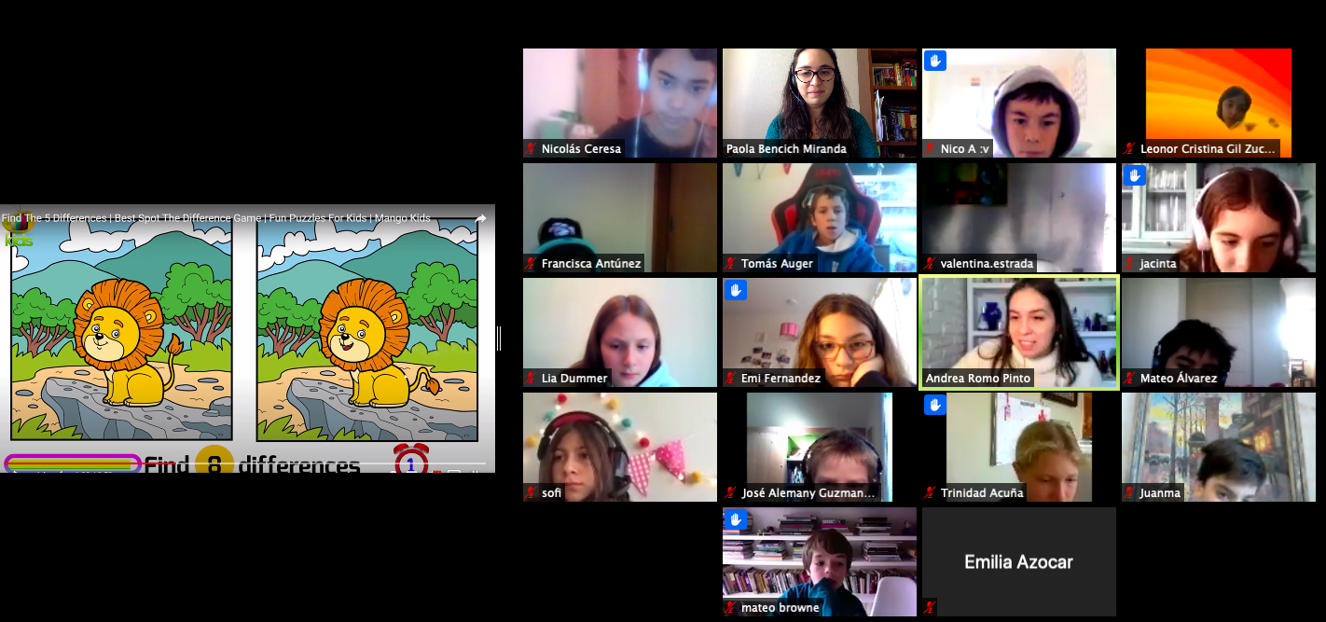
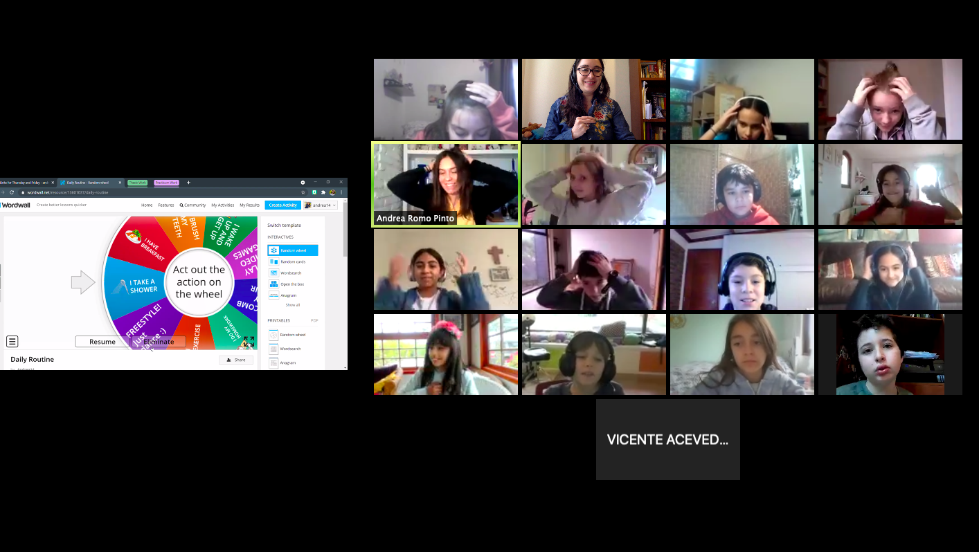
I Unit - 4th Grade 4
II Unit - 5th Grade 14
5th grade participated in a fun game called: “Spot the Difference” where the kids looked for the differences between two pictures. It was a fun speaking activity where all the class participated actively.
8E closely studying the image!
5B showing off their dance moves!
5th grade danced to the rhythm of music while a roulette gave them an action to perform from their daily routines.

Slide 15
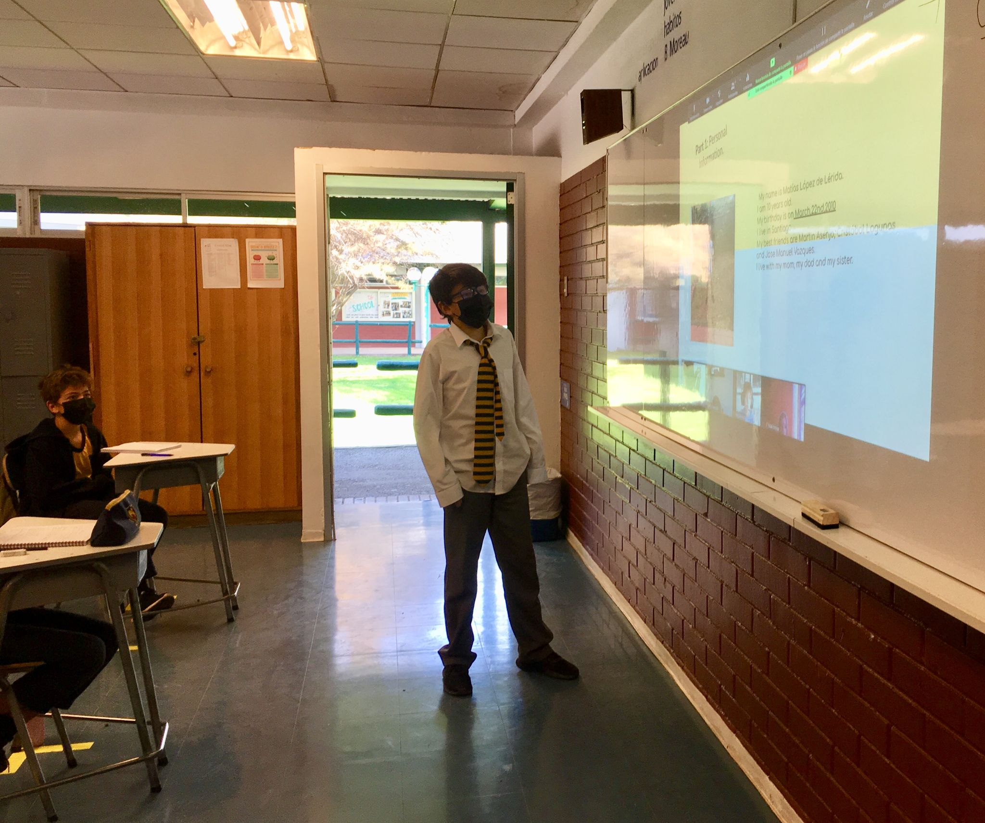
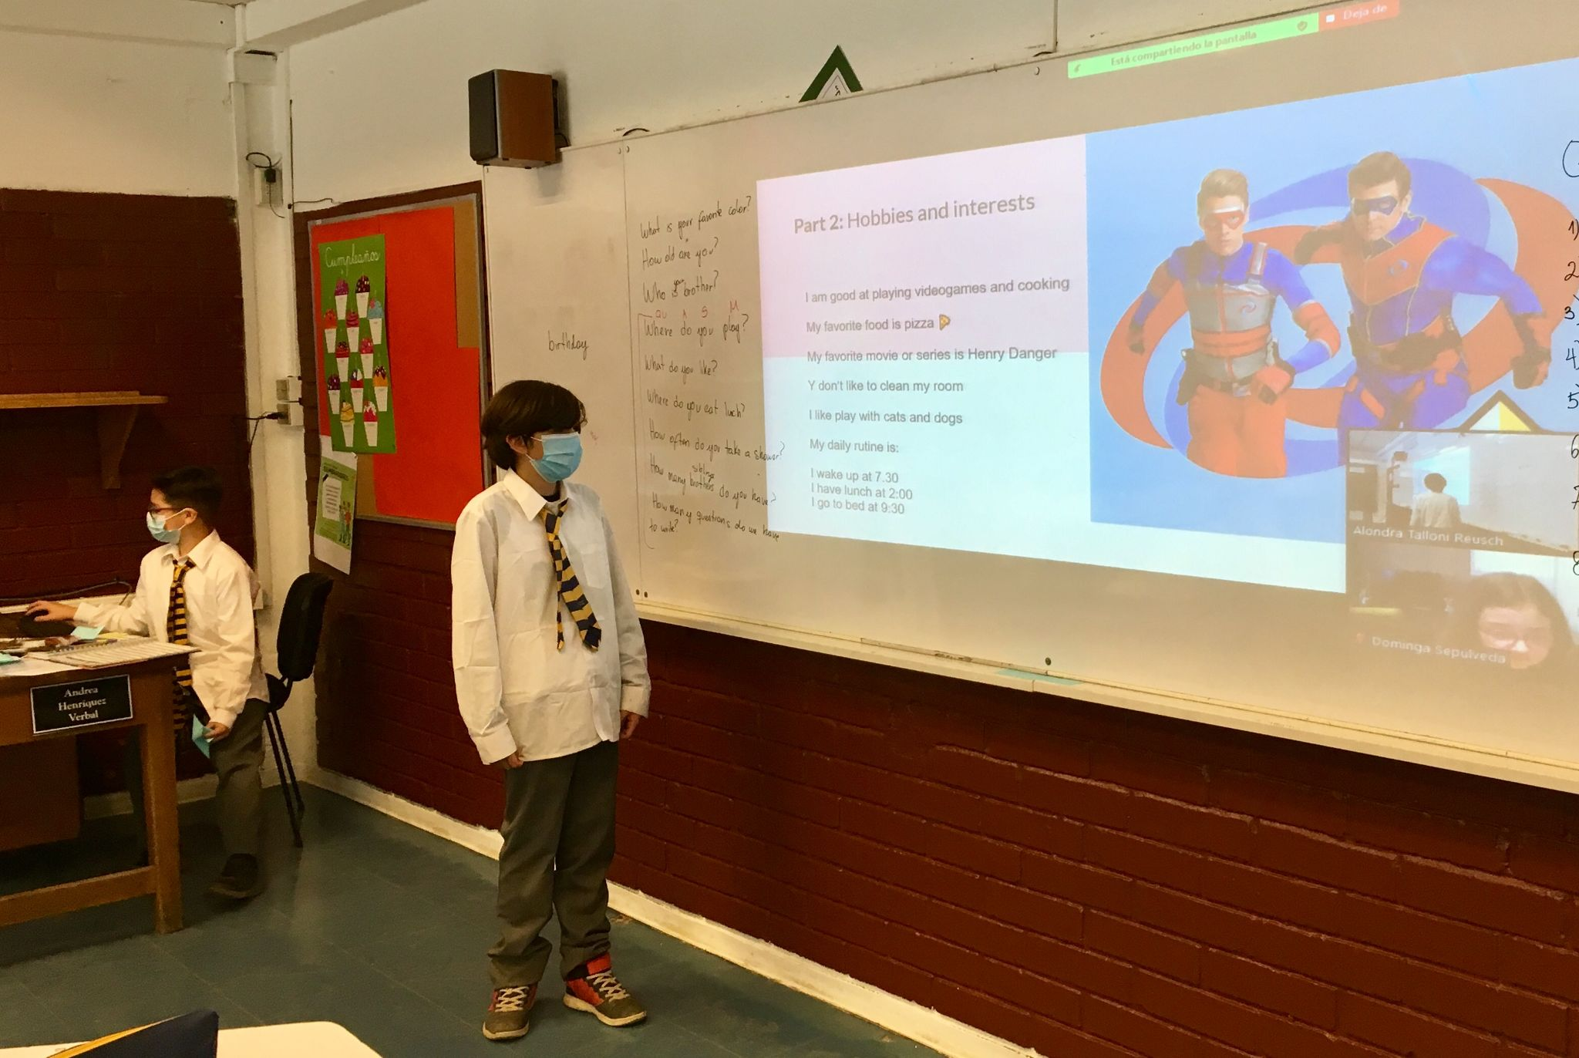
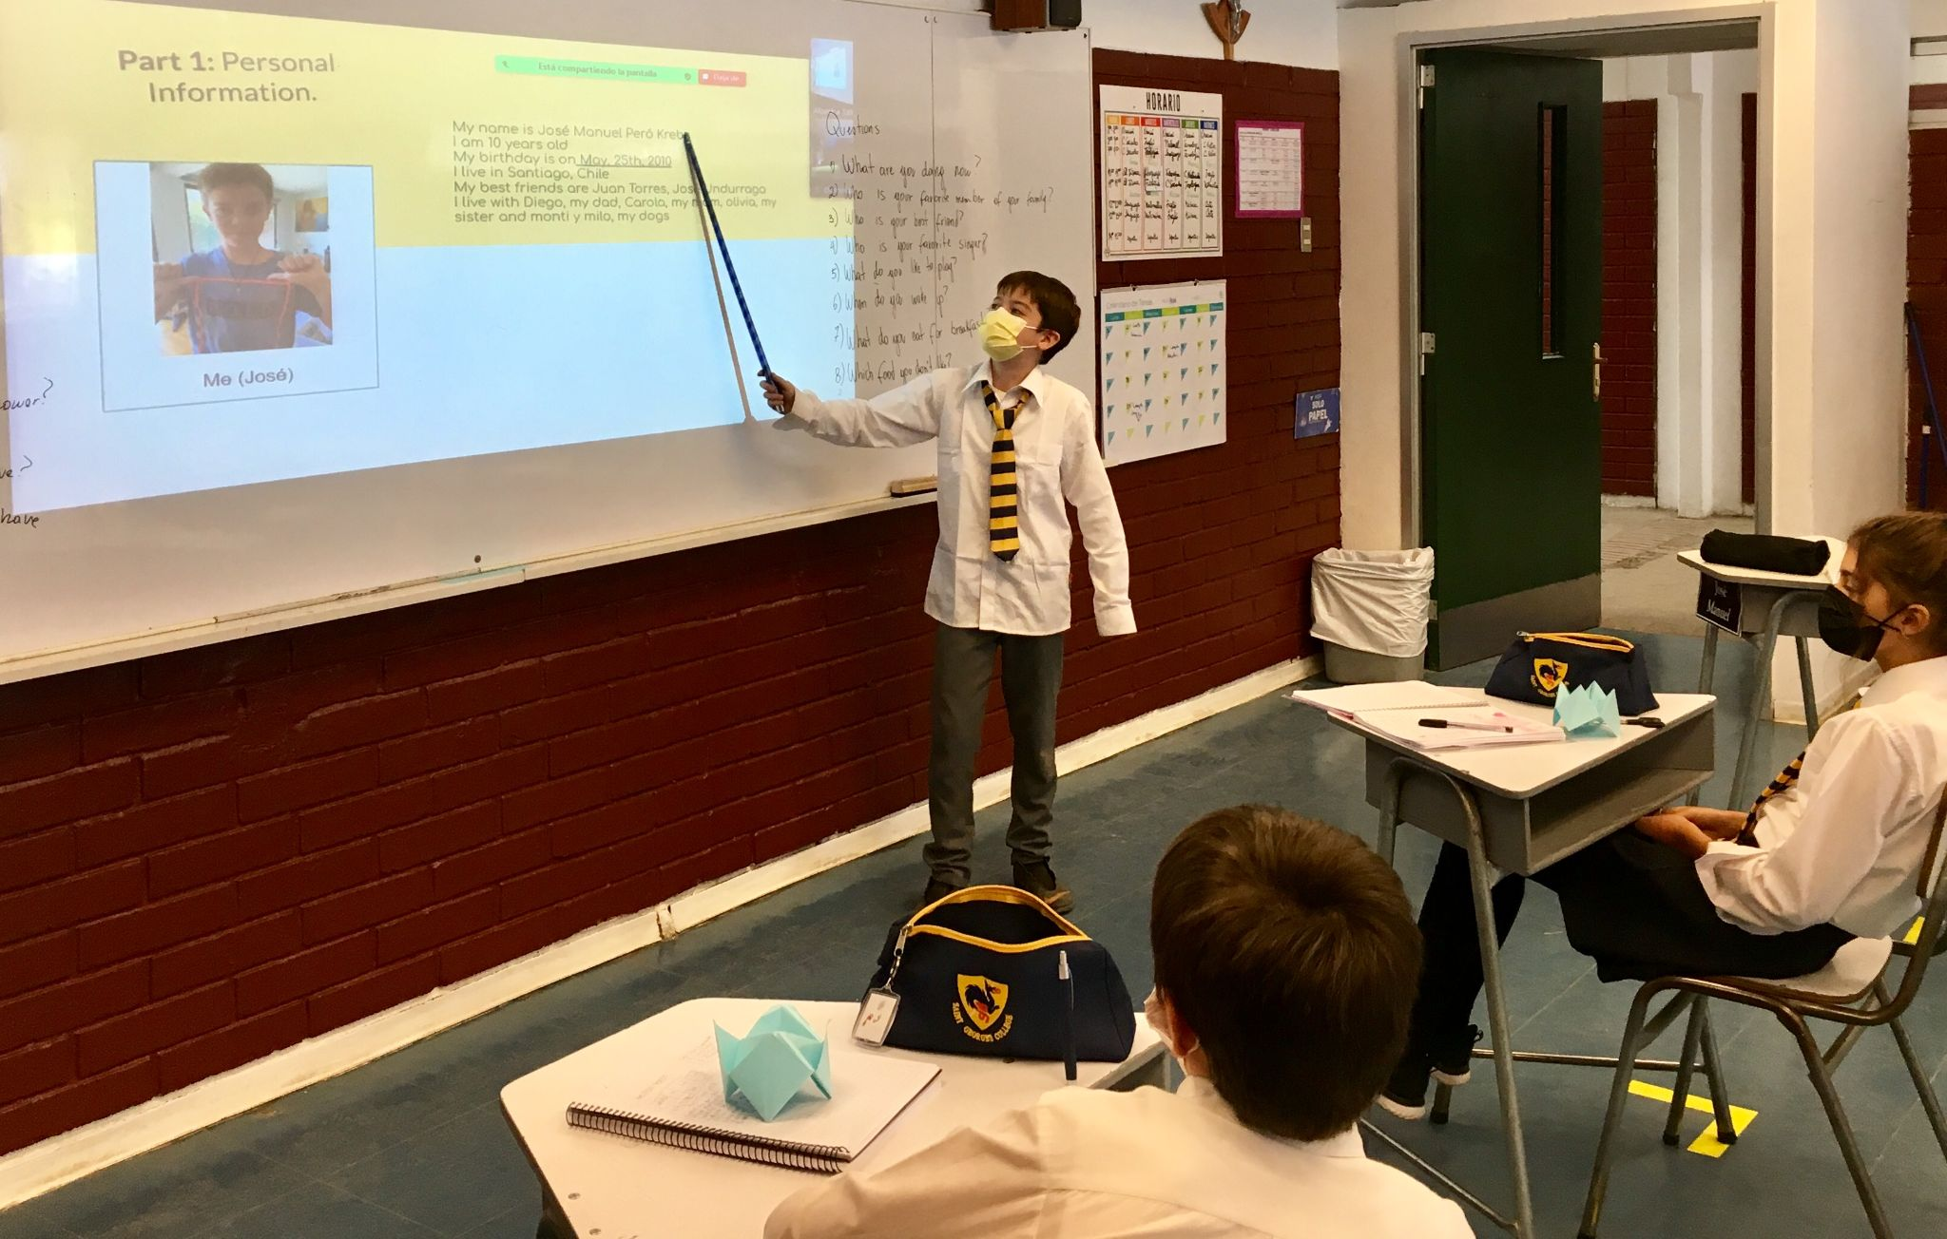
I Unit - 4th Grade 4
II Unit - 5th Grade (continued) 15
Students did a project in which they had to describe a family member, their family, and themselves. Some students shared their work with the class during in-person classes.
Matías, 5A
Santiago, 5B
José, 5B

Slide 16
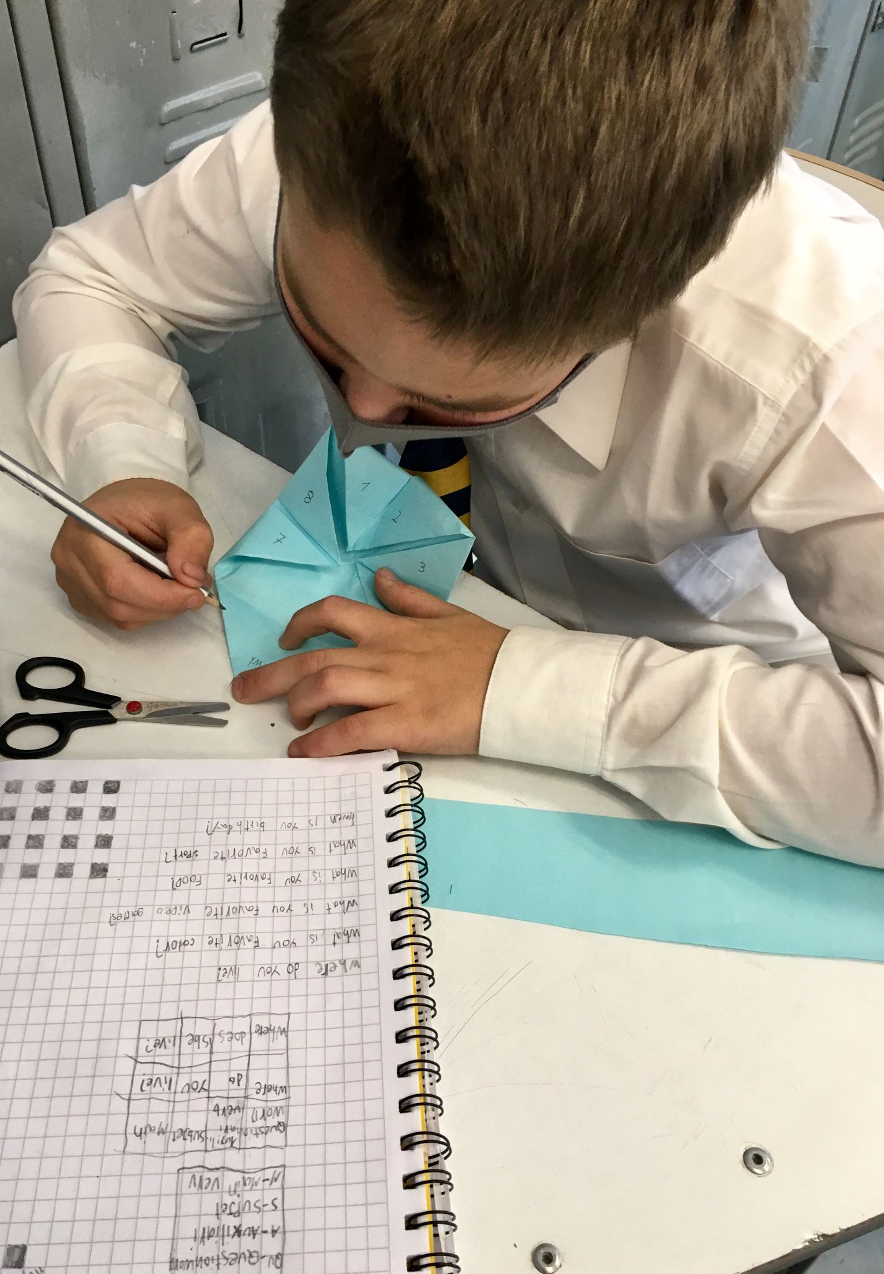
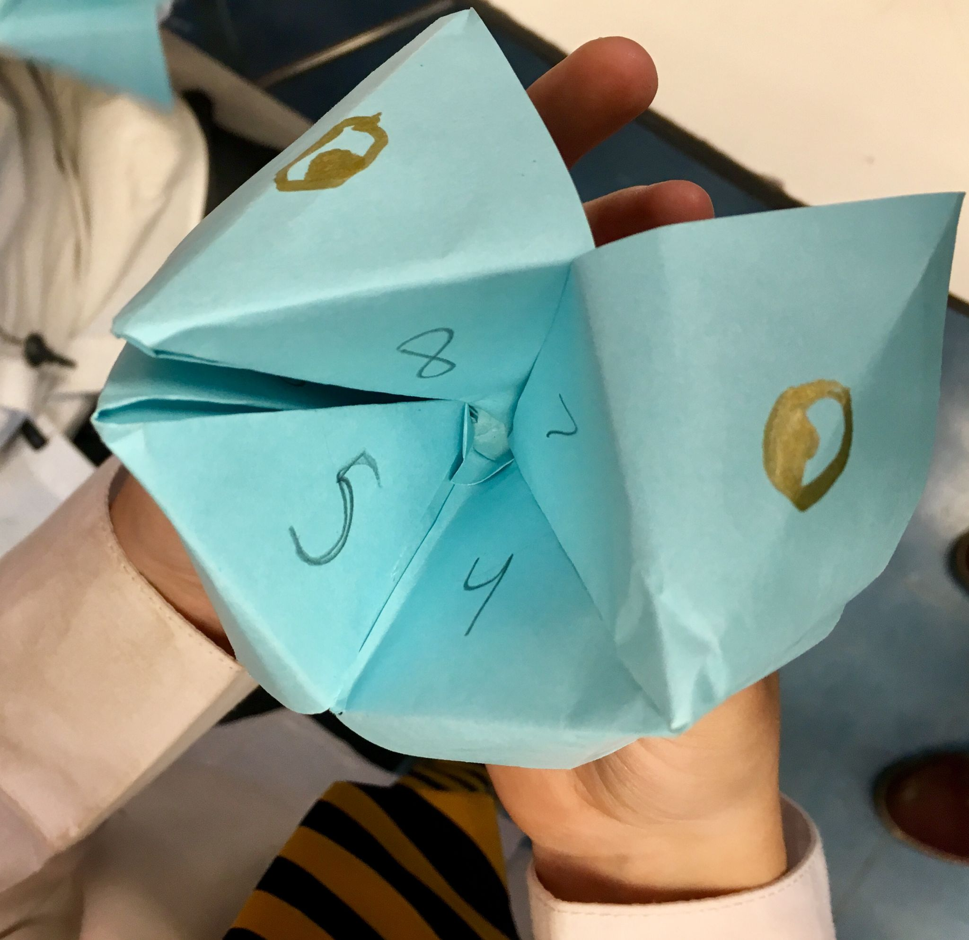
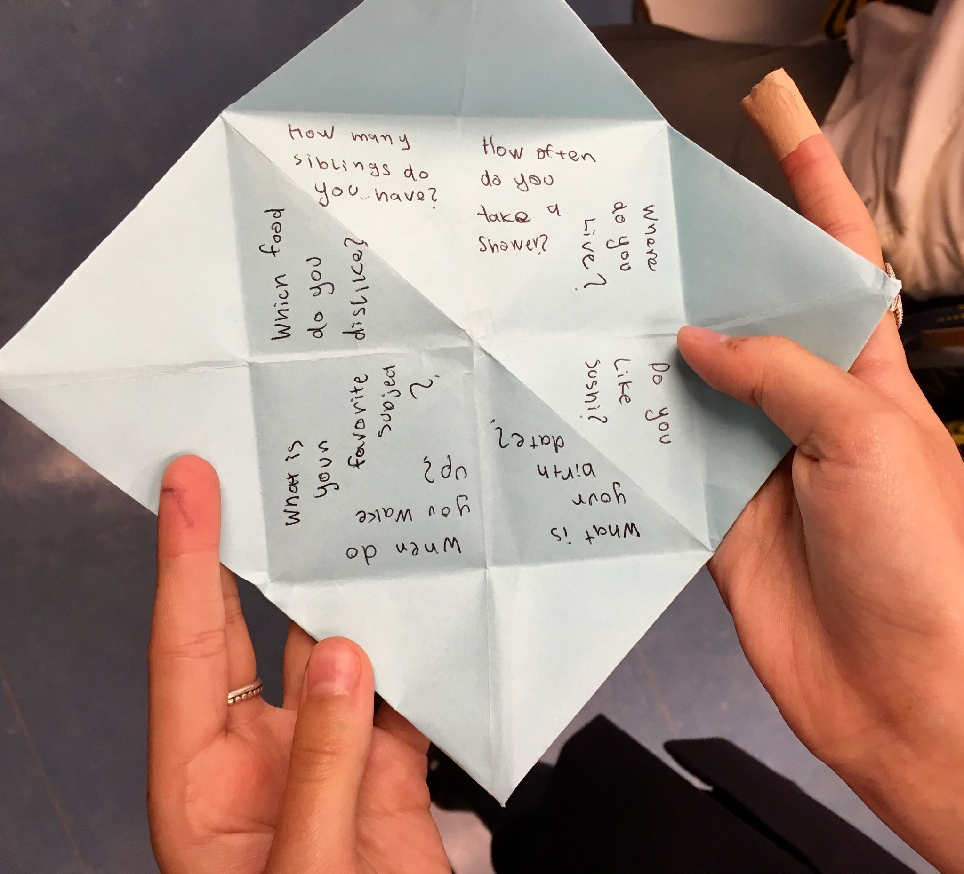
I Unit - 4th Grade 4
II Unit - 5th Grade (continued) 16
Students created an origami fortune teller and wrote questions inside it to practice question formation and learn more about their classmates.
Julian, 5B works carefully to create his fortune teller.
Ignacio, 5B shows his fortune teller.
María, 5B shows the questions she created for her fortune teller.

Slide 17
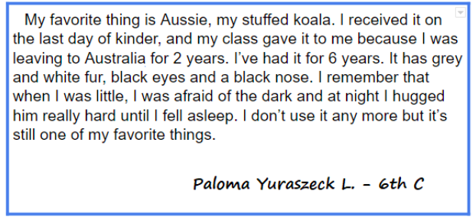
I Unit - 4th Grade 4
II Unit - 6th Grade 17
Students wrote a paragraph about their favorite thing.
To express ideas about their topic, students wrote a paragraph and applied sentence structure, verb tenses, grammar points, and 6 traits for writing.

Slide 18
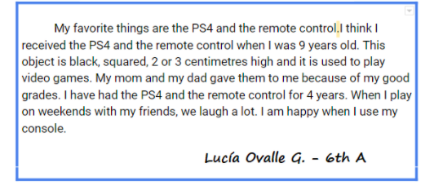
I Unit - 4th Grade 4
II Unit - 6th Grade (continued) 18

Slide 19
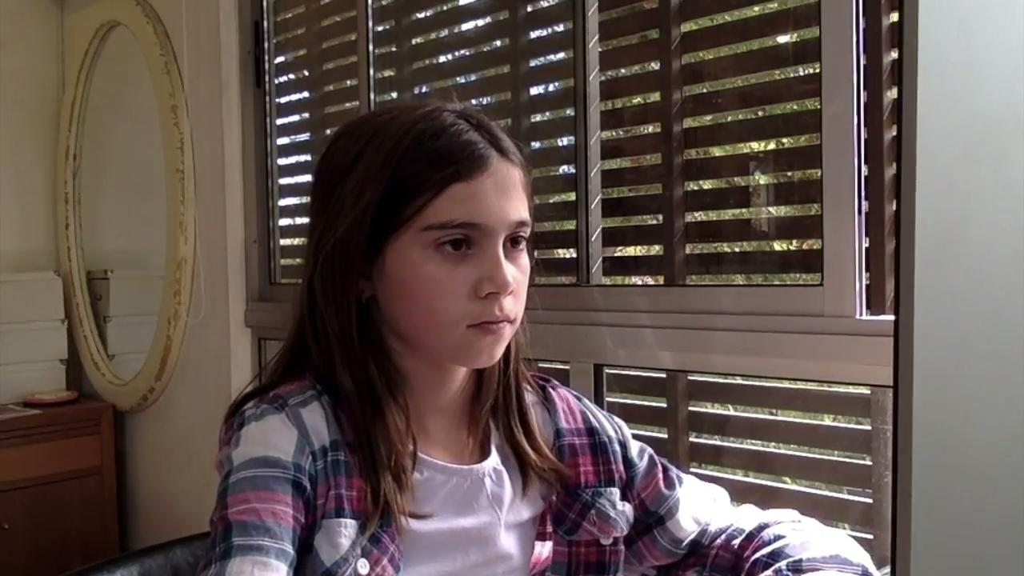
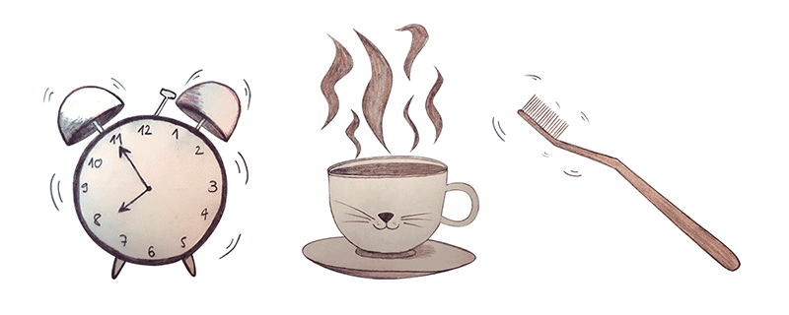
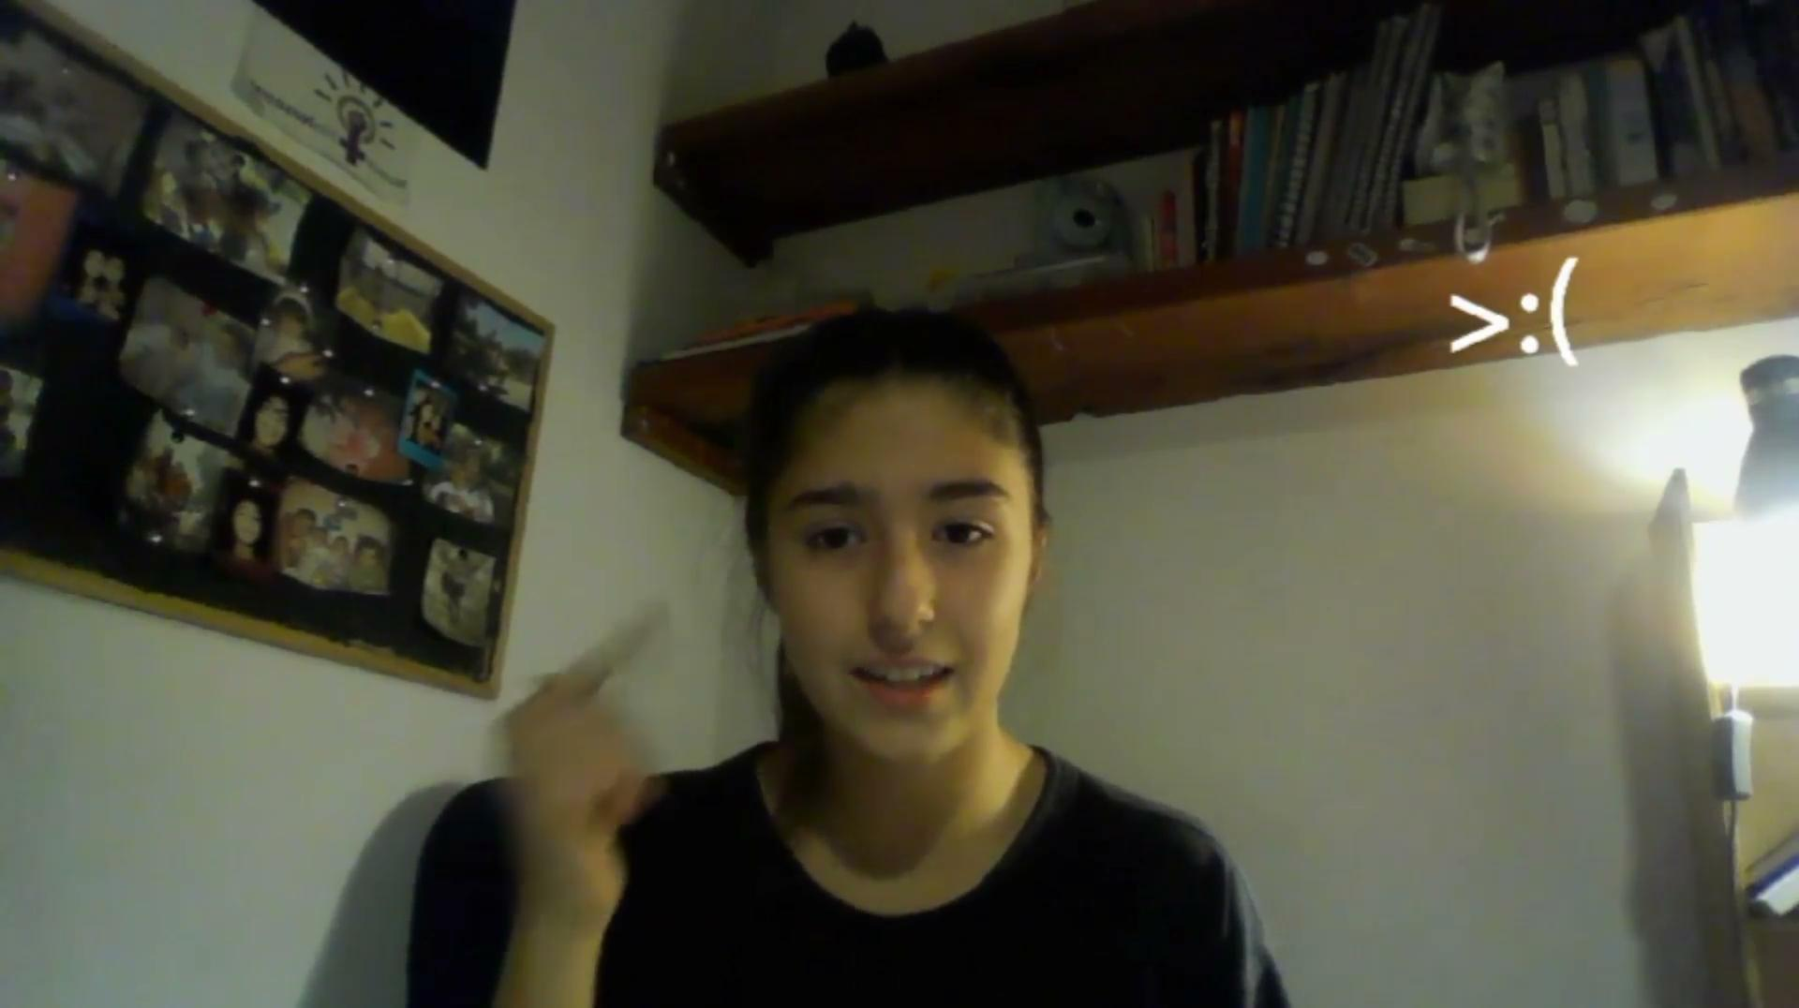
II Unit- 7th Grade 19
“My Day in a Nutshell”
Leonor, 7B
This first bimester, 7th Graders had some fun sharing a regular day in their lives. They worked on writing their scripts using simple present and literary techniques.
Later, they peer edited their scripts and created videos combining their text and images.
Belén, 7D

Slide 20
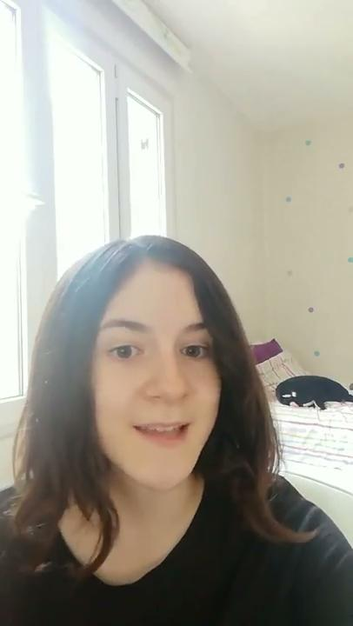
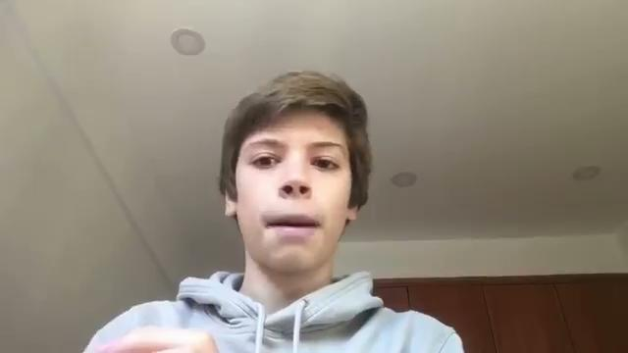
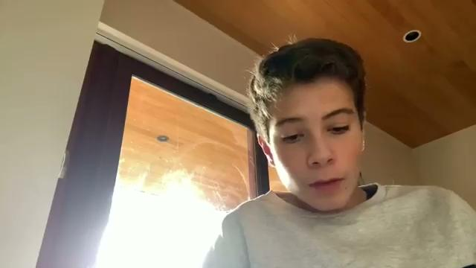
II Unit - 8th Grade 20
Flipgrid Project: In Bimester 1, 8th graders shared about themselves, their school, and their culture with students in the United States.
Colomba, 8E
Lucas, 8B
Juan José, 8B

Slide 21
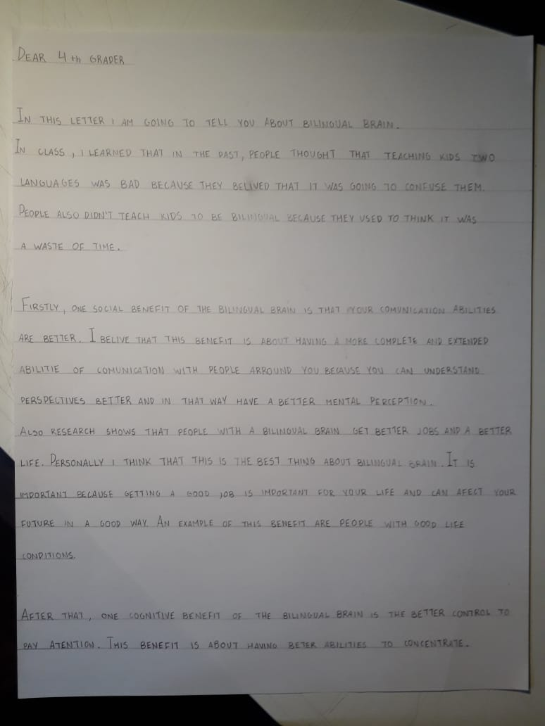
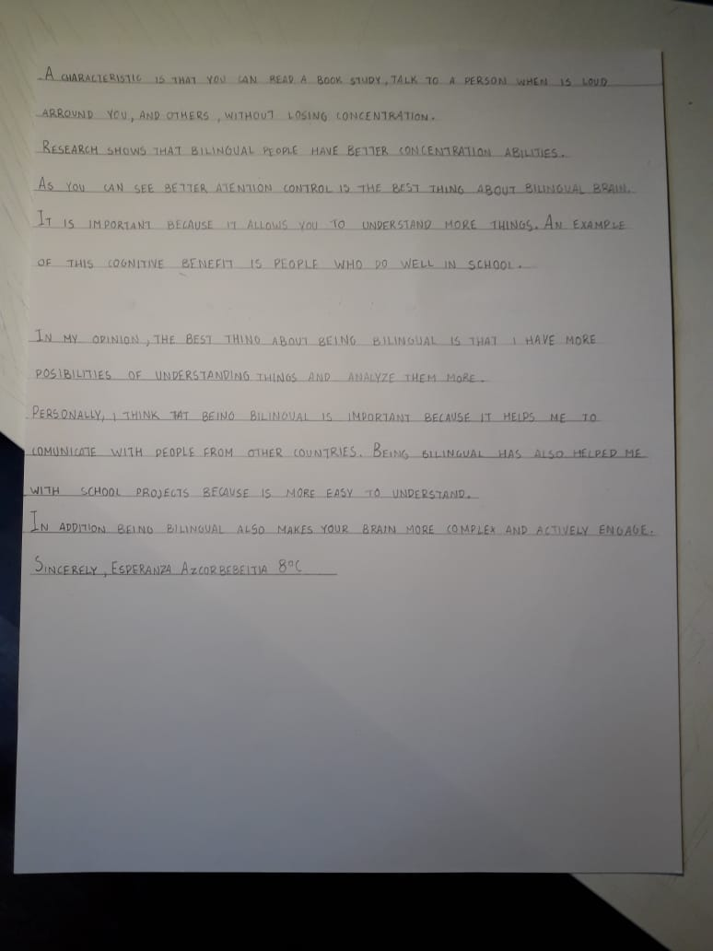
II Unit - 8th Grade (continued) 21
8th Grade students also learned about the benefits of having a bilingual brain. Students learned about social and cognitive benefits of the brain before reflecting upon why it is important for themselves to learn another language. Then, they practiced applying their new knowledge in writing a letter to 4th grade students!
Esperanza, 8C

Slide 22
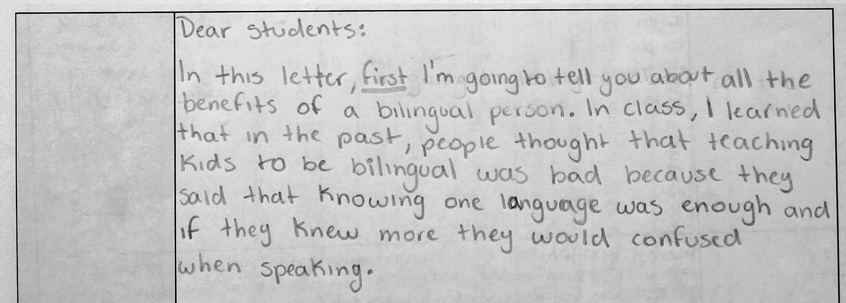
II Unit - 8th Grade (continued) 22
Trinidad, 8B

Slide 23
III Unit - 9th Grade 23
9th Grade reflected on who they are as individuals and how their identity determines how they see the world around them. To demonstrate their understanding of the unit, they designed and created a calligram to create a vivid impression of themselves.
Montserrat, 9B
Catalina, 9D
Agatha, 9E

Slide 24
III Unit - 9th Grade (continued) 24
Clara, 9A
Olivia, 9C
Laura, 9A

Slide 25
III Unit - 11th Grade 25
1th grade wrote different types of texts, considering content and format requirements. Students wrote a short story which focused on subject-verb agreement or how to avoid run-on sentences, a review of either a film or a novel using different phrasal verbs, or a letter or email which focused on is the proper use of second and third conditional. In every case, they had to answer an question.
Click here to read short stories!
Click here to read some reviews!
Click here to read letters!

Slide 26
III Unit - 12th Grade - Global English 26
12th grade students in the Global English module developed academic vocabulary related to language and linguistics. The students learned about where and how English is used and reflected on how cultural identities impact language use. Students created illustrated dictionaries of some of their favorite linguistic terms that included applications in English and Spanish.
Caetano (12E) and Clara (12E) explain Chilean pronunciation to our American language partners.
Pablo, Vicente, and Baltazar (12D) explain linguistic characteristics of Spanish to our American language exchange partners

Slide 27
III Unit - 12th Grade - Global English (continued) 27
Santiago (12B) illustrates cultural influences on language on the cover of his bimester project.
Cristóbal (12B), Julieta (12B), Belén (12B), and Paulo (12C) explain linguistic characteristics of Spanish to our American language exchange partners.
Fernanda’s (12D) explanation of Mapuche influences on Chilean Spanish

Slide 28
III Unit - 12th Grade -Forensic Science 28
During Bimester 1, 12th grade learned about the importance of evidence and evidence collection
techniques to forensic science. They researched a criminal case and delivered a presentation to their classmates about the details of the case and, specifically, any evidence that was important to the case.
Bernardita (12D), Candelaria, (12E), Felipe (12C), Valentina (12B), Emilia (12B), Maite (12C), Paula (12B)

Slide 29
III Unit - 12th Grade - Science Fiction 29
Students in the 12th grade Science Fiction English elective are writing their very own Science Fiction short stories! They have been learning about the characteristics of Science Fiction as well as the elements of narrative writing. Here, we share some teasers of their stories, which are truly out of this world!
Click here to access samples of the 12th grade Science Fiction class!

